Slide 1
Ch. 4 Temperature and Heat
Notes:
All notes and information we retrieved from McDougall Littell Physical Science textbook 2006

Slide 2
Warm up (11-20-15)
Do you think that heat and temperature are the same thing?
Use specific information from your daily lives to help explain your answers.

Slide 3
Outline
Objectives
Heat vs. Temperature Lab Introduction
Read ch. 4.2 – 4.3
P. 114 chapter 4.2 review questions 1-6
P. 121 chapter 4.3 review questions 1-6

Slide 4
Objectives
To investigate whether or not heat and temperature are the same thing by completing the heat vs. temperature lab

Slide 5
Heat vs. Temperature

Slide 6
Heat vs. Temperature Lab NB Set UP
Title: Heat v. Temperature Lab
Prediction: Students need to write a prediction as to whether or not heat and temperature are the same thing. They should include evidence in their answers.
Data: Students need to copy the data table below into their notebook at this section
Graph: Students need to leave room for the graph for their data
(in*C) | Initial | 1 min | 2 min | 3 min | 4 min | 5 min | 6min | 7min | 8min | 9min | 10min
100mL
200mL

Slide 7
Warm up (11-23-15)
Come up with another example where people use two different common terms to mean the same thing when those words actually have different scientific meanings.
Get out your heat vs. temperature lab information and composition notebooks

Slide 8
Outline
Objectives
Heat vs. Temperature Lab

Slide 9
Objectives
To investigate whether or not heat and temperature are the same thing by completing the heat vs. temperature lab

Slide 10
Warm up (11-24-15)
What are some areas of our experimental design for this experiment that we could have fixed in order to produce more trustworthy results
Think about what areas of the lab maybe didn’t go so smoothly and explain how we could do that differently in order to produce a more valid experiment.

Slide 11
Outline
Objectives
Heat vs. Temperature Lab
Mixing Warm and Cold Water Lab Prep
Mixing Warm and Cold Water Notebook Setup

Slide 12
Objectives
To investigate whether or not heat and temperature are the same thing by completing the heat vs. temperature lab

Slide 13
Mixing Warm and Cold Water

Slide 14
Warm up (11-30-15)
Explain in your own words the difference between heat and temperature.

Slide 15
Outline
Objectives
Mixing Warm and Cold Water Lab

Slide 16
Objectives
To investigate what will happen when warm and cold water will mix, and to determine what happens to the heat either lost or gained during the experiment.

Slide 17
Warm up (12-1-15)
What are some areas of the mixing warm and cold water lab that we can improve upon our experimental design?
Think about how we can get more valid results.

Slide 18
Outline
Objectives
Mixing Warm and Cold Water Lab Analysis
Ch. 4 notes

Slide 19
Objectives
To analyze what happened when warm and cold water will mix, and to determine what happens to the heat either lost or gained during the experiment.
To take notes and gain background information about ch. 4

Slide 20
What you learned before…
All matter is made up of __________
Particles
_________ energy is the energy in motion
Kinetic
Energy can be transferred or changed but it is never __________ or _________
Created or destroyed

Slide 21
What you will learn now…
Temperature depends on kinetic energy
How temperature is measured
How changes in temperature can affect matter

Slide 22
Warm up (12-2-15)
What are some questions you have about ch. 4?
If you don’t have any questions or if we didn’t get to it, what are some things that you find interesting about this chapter?

Slide 23
Outline
Objectives
Ch. 4 notes
Heat of Fusion Lab Prep

Slide 24
Objectives
To finish taking notes and gaining background information on Ch. 4
To prepare for the heat of fusion lab

Slide 25
What you learned before…
All matter is made up of __________
Particles
_________ energy is the energy in motion
Kinetic
Energy can be transferred or changed but it is never __________ or _________
Created or destroyed

Slide 26
What you will learn now…
Temperature depends on kinetic energy
How temperature is measured
How changes in temperature can affect matter

Slide 27
Temperature depends on particle movement
Kinetic Theory of Matter
All particles that make up matter are constantly in motion
Helps explain solid, liquid, and gases
Particles in a solid aren’t very free to move. Vibrate back and forth, held tightly together by forces of attraction
Particles in a liquid move freely, constantly sliding past and tumbling over each other
Particles in a gas are far apart and move at high speeds, might collide but typically don’t interact with other particles

Slide 28
Temperature and Kinetic Energy
Temperature: measure of the average kinetic energy of all particles in an object
The warmer the temperature, the more quickly the particles are moving, the higher average kinetic energy
The cooler the temperature, the more slowly the particles are moving, the lower average kinetic energy

Slide 29
Temperature doesn’t just measure speed of particles
measure of average kinetic energy of the particles
KE depends on both mass and speed
How does temperature change if KE was increased??

Slide 30
Measuring Temperature
Fahrenheit, Celsius, Kelvin
Fahrenheit – most common, pure water freezes at 32 degrees and boils at 212 degrees
Celsius – scientific scale, pure water freezes at 0 degrees and boils at 100 degrees
Kelvin – absolute zero, there are no negatives
Would you need a coat if I told you it was 30 degrees outside?

Slide 31
From To Fahrenheit To Celsius To Kelvin
Fahrenheit (F) F (F - 32) * 5/9 (F - 32) * 5/9 + 273.15
Celsius (C or º) (C * 9/5) + 32 C C + 273.15
Kelvin (K) (K - 273.15) * 9/5 + 32 K - 273.15 K

Slide 32
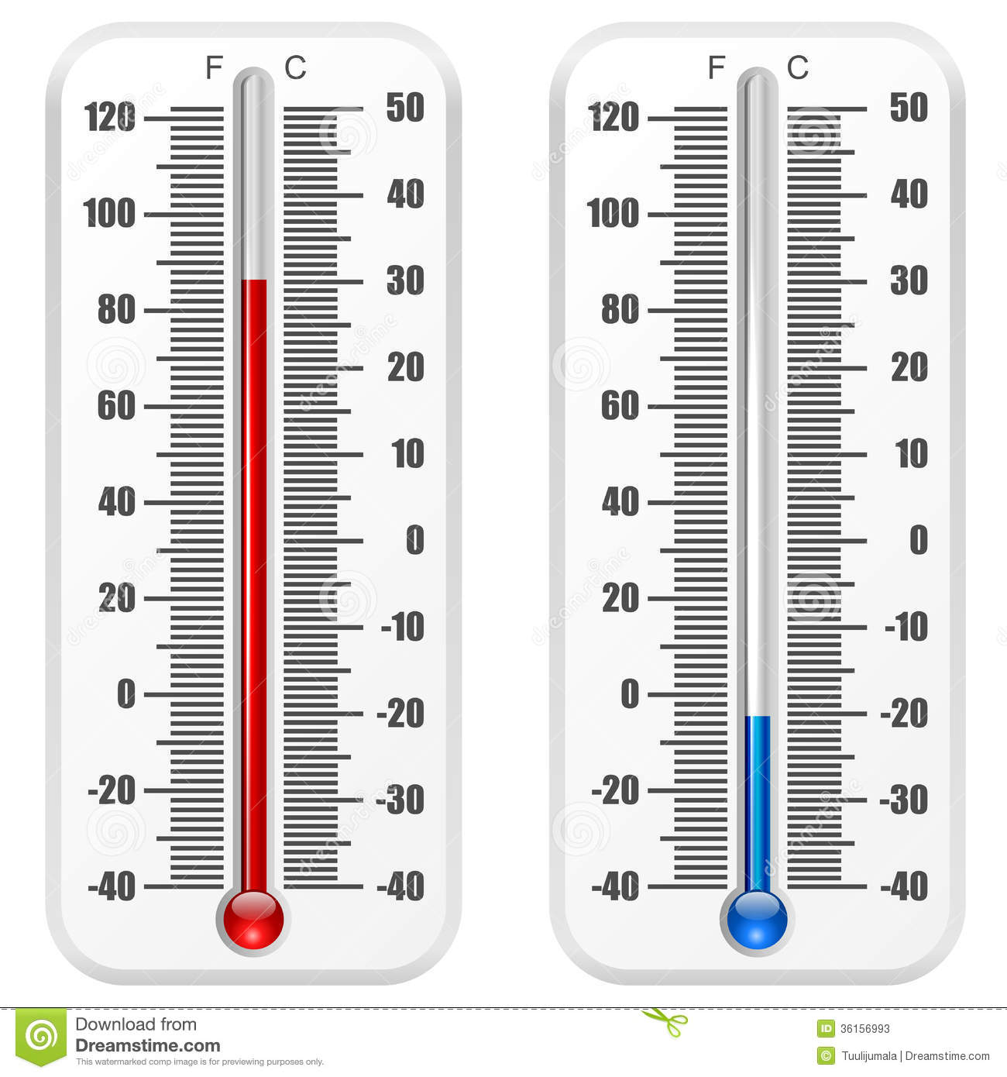
Notes:
http://thumbs.dreamstime.com/z/standard-thermometer-vector-template-isolated-white-background-36156993.jpg

Slide 33
Measuring Temperature
Thermometers: typically the liquid inside the thermometer expands or contracts in a response to the temperature of what you are measuring
Liquid filled – measure how much the liquid expands in a narrow tube as temperature increases
Thermal Expansion : why liquid filled thermometers work
Affects many substances
Occurs in most solids and all gases

Slide 34
Energy Flow
From warmer objects to cooler objects
Heat is different from temperature
Heat is the flow of energy from an object at a higher temperature to an object at a lower temperature
Thermal energy: total random kinetic energy of particles in an object
Temperature is an average, thermal energy is a total

Slide 35
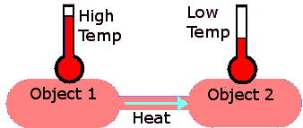
Notes:
http://electron6.phys.utk.edu/101/CH7/7.1/Image15.gif

Slide 36
Measuring Heat
calorie (c) : amount of energy needed to raise the temperature of 1 gram of water by 1 degree Celsius
Joule (J) : standard scientific unit of energy
1 calorie = 4.18 joules
calorie and Calorie (C) aren’t the same thing
In food, one Calorie is actually a kilocalorie or 1000 calories
Calorimeter – burn the food and measure the amount of energy released through heat

Slide 37
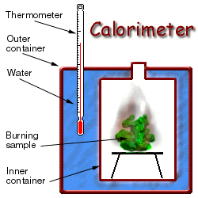
Notes:
http://www.brooklyn.cuny.edu/bc/ahp/BE/Investigations/Calorimeter.GIF

Slide 38
Specific Heat
Some substances change temperature easily when compared to others
High specific heat : that substance has to absorb large quantities of energy for its temperature to increase and must release a large quantity of energy for its temperature to decrease
Thermal energy also depends on object’s mass because TE is total KE of all particles in an object
Temperature of large bodies of water change slowly… lot of mass, lot of particles

Slide 39
Heat Transfer
Conduction: transfer of energy through touching
Conductors: transfer heat easily
What are wires made out of in walls? Why?
Insulators: poor conductors of heat
Why do you think this is important when talking about insulation in your house?
Convection: transfer of energy through movement of large numbers of particles in the same direction in a liquid or gas
Warm water is less dense than cold water
Temp increases, molecules spread out, become less dense
Radiation: energy traveling in waves
Electromagnetic waves: visible light, microwaves, infrared light
Can travel through empty space

Slide 40
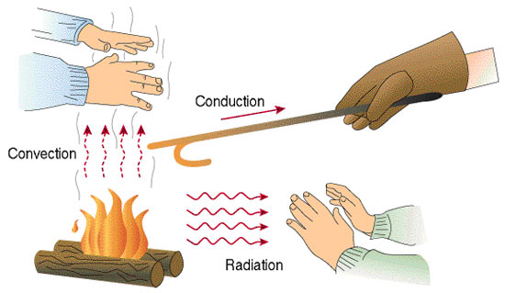
Notes:
http://schoolworkhelper.net/wp-content/uploads/2010/08/Convection-Conduction.jpg

Slide 41
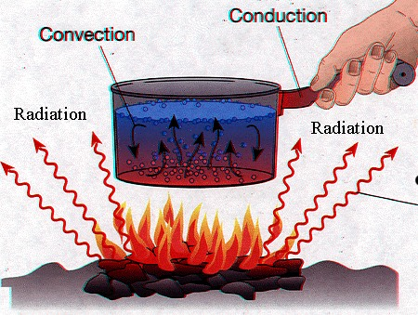
Notes:
http://www.aos.wisc.edu/~aalopez/aos101/wk5/heatrans.jpg

Slide 42
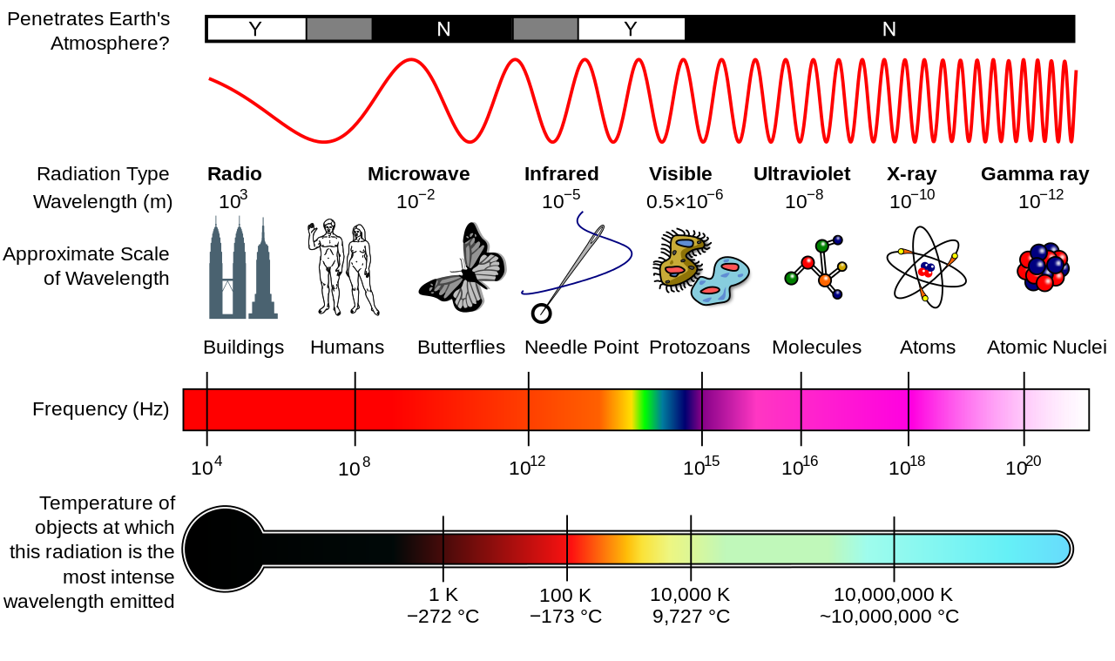
Notes:
http://upload.wikimedia.org/wikipedia/commons/thumb/c/cf/EM_Spectrum_Properties_edit.svg/1280px-EM_Spectrum_Properties_edit.svg.png

Slide 43
Read to Learn! Page 119
Starting at the bottom of the page, read through the section titled “different materials are used to control the transfer of energy”
This section goes on to the next page. Read all the way to the end of the section.
When you finish, be sure to look at the pictures to really understand what this section is talking about.
When you are done, summarize what was just said in your own words. Explain the important parts of the reading and include examples.

Slide 44
Warm up (12-3-15)
What do you think is the purpose of the heat of fusion lab?
How do you think this lab relates to the chapter we are currently talking about? Be specific.

Slide 45
Outline
Objectives
Finish Chapter 4 notes – specific heat of water demonstration
Heat of Fusion Lab Prep

Slide 46
Objectives
To prepare for the heat of fusion lab
To conduct the heat of fusion lab in order to determine how this lab relates to our chapter on energy.
Use a calorimeter
Use a computer to make temperature measurements
Use a computer to analyze the data collected
Determine heat of fusion for ice (in J/g)

Slide 47
Specific Heat
Some substances change temperature easily when compared to others
High specific heat : that substance has to absorb large quantities of energy for its temperature to increase and must release a large quantity of energy for its temperature to decrease
Thermal energy also depends on object’s mass because TE is total KE of all particles in an object
Temperature of large bodies of water change slowly… lot of mass, lot of particles

Slide 48
Specific Heat of Water Demonstration
https://search.yahoo.com/yhs/search?p=specific+heat+of+water+using+a+balloon+and+fire&ei=UTF-8&hspart=mozilla&hsimp=yhs-002

Slide 49
Heat Transfer
Conduction: transfer of energy through touching
Conductors: transfer heat easily
What are wires made out of in walls? Why?
Insulators: poor conductors of heat
Why do you think this is important when talking about insulation in your house?
Convection: transfer of energy through movement of large numbers of particles in the same direction in a liquid or gas
Warm water is less dense than cold water
Temp increases, molecules spread out, become less dense
Radiation: energy traveling in waves
Electromagnetic waves: visible light, microwaves, infrared light
Can travel through empty space

Slide 50
Notes:
http://schoolworkhelper.net/wp-content/uploads/2010/08/Convection-Conduction.jpg

Slide 51
Notes:
http://www.aos.wisc.edu/~aalopez/aos101/wk5/heatrans.jpg

Slide 52
Notes:
http://upload.wikimedia.org/wikipedia/commons/thumb/c/cf/EM_Spectrum_Properties_edit.svg/1280px-EM_Spectrum_Properties_edit.svg.png

Slide 53
Read to Learn! Page 119
Starting at the bottom of the page, read through the section titled “different materials are used to control the transfer of energy”
This section goes on to the next page. Read all the way to the end of the section.
When you finish, be sure to look at the pictures to really understand what this section is talking about.
When you are done, summarize what was just said in your own words. Explain the important parts of the reading and include examples.

Slide 54
Warm up (12-4-15)
What are some suggestions you can give to other scientists who are going to conduct this heat of fusion experiment? What should they look out for?

Slide 55
Outline
Objectives
Heat of Fusion Lab

Slide 56
Objectives
To conduct the heat of fusion lab in order to determine how this lab relates to our chapter on energy.
Use a calorimeter
Use a computer to make temperature measurements
Use a computer to analyze the data collected
Determine heat of fusion for ice (in J/g)

Slide 57
Warm up (12-7-15)
What are some of the results you are seeing in the heat of fusion lab so far? Try to explain those results and why you got them. (for example, if you have unexpected results, explain how you got those results. If you don’t have unexpected results, explain the results you do have and how we can give meaning to those results)

Slide 58
Outline
Objectives
Heat of Fusion Lab
Heat of Fusion Lab Analysis
Convection current demonstration

Slide 59
Objectives
Use a calorimeter
Use a computer to make temperature measurements
Use a computer to analyze the data collected
Determine heat of fusion for ice (in J/g)
To conduct the heat of fusion lab in order to determine how this lab relates to our chapter on energy.
To analyze our results from the heat of fusion lab and determine what those results mean.

Slide 60
Convection Current Demonstration
https://search.yahoo.com/yhs/search?p=steve+spangler+science+convection+current+demonstration&ei=UTF-8&hspart=mozilla&hsimp=yhs-002

Slide 61
Warm up (12-8-15)
What scientific principle is the lava lamp lab going to demonstrate? Explain how that principle works and how it relates to our chapter.

Slide 62
Outline
Objectives
Make a Lava Lamp

Slide 63
Objectives
To create a lava lamp to demonstrate convection within a system.
Explain how convection currents apply to processes seen on Earth

Slide 64
Lava Lamp Creation
Observations:
Explanations:
Identify as many areas as you can think of where you see convection on Earth.
You will need to research where convection is found on Earth and describe those processes in this section to help provide evidence for your answer.

Slide 65
Warm up (12-9-15)
Given the equation H = ∆TmC_{p}
Solve the following equations for heat in joules
Change in temp = 22*, m = 16g, C_{p} = 3.16
H =
Initial temp = 14* Final temp = 30*, m = 5g, C_{p} = 6.1
H =

Slide 66
Outline
Objectives
Make a Lava Lamp
Heat Equations Practice
Video: NOVA megastorm

Slide 67
Objectives
To create a lava lamp to demonstrate convection within a system.
To practice calculating heat when given mass and specific heat
To watch the NOVA video to wrap up the chapter on energy

Slide 68
NOVA inside the Megastorm
http://video.pbs.org/video/2305482040/

Slide 69
Warm up (12-10-15)
Are there any questions or concepts from this semester that you have and would like to go over?
IF you don’t have any questions, please write down some of the things that you remember from this semester and explain the concepts associated with them.

Slide 70
Outline
Objectives
Video: NOVA megastorm

Slide 71
Objectives
To watch the NOVA video to wrap up the chapter on energy
Relate the concepts of convection, conduction, and radiation to the NOVA Megastorm video
Explain the concept of energy and energy transfer as it is represented in real life situations

Slide 72
NOVA inside the Megastorm
http://video.pbs.org/video/2305482040/

Slide 73
Warm up (12-11-15)
Explain the concept of convection, conduction, and radiation.
Give an example of where each of these is found.

Slide 74
Outline
Objectives
Video: NOVA megastorm

Slide 75
Objectives
To watch the NOVA video to wrap up the chapter on energy
Relate the concepts of convection, conduction, and radiation to the NOVA Megastorm video
Explain the concept of energy and energy transfer as it is represented in real life situations

Slide 76
NOVA inside the Megastorm
http://video.pbs.org/video/2305482040/

Slide 77
Warm up (12-14-15)
Explain one thing that you did really well this semester to help you be successful in my class.
Explain one thing that you could improve on for next semester in order to be more successful in my class.

Slide 78
Outline
Objectives
Review for Final
Review Game

Slide 79
Objectives
Review for the final exam by playing the review jeopardy game
Prepare for the final exam by reviewing concepts from throughout the semester.

Slide 80
Warm up (12-15-15)
Explain everything you remember from this chapter.
Be specific. Think about heat transfer, conduction, convection, radiation, temperature, heat, thermal energy, and energy

Slide 81
Outline
Objectives
Make a Lava Lamp
Video: NOVA megastorm

Slide 82
Objectives
Review for the final exam by playing the review jeopardy game
Prepare for the final exam by reviewing concepts from throughout the semester.

