Slide 1
Physical Science

Slide 2
Warm-up (9-14-15)
Explain what you need to do after collecting data and a graph appears on the LabQuest. Also explain how you rename that data.

Slide 3
Outline
Objectives
Experiment Creation Practice
LabQuest Demonstrations & Logger Pro

Slide 4
Objectives
I will be able to articulate the importance of experimental design.
I will be able to identify the parts of experimental design from various laboratory scenarios
I will be able to apply the aspects of experimental design when designing my own experiment.
I will be able to demonstrate proper usage of a LabQuest as well as how to use Logger Pro

Slide 5
Experiment Creation
You need one piece of paper per table groups
Everyone’s name needs to be on that paper
As a group, you are to design an experiment to test the effects of sugar on the human body.
Please identify the parts of experimental design for your experiment – Independent variable, dependent variable, control, and constants
Be specific to mention what exactly you will be testing when trying to see how sugar affects the body.

Slide 6
Experiment Creation
Now that your group has identified the parts of experimental design, you are to switch experiments with another group
Read through their experiment and the parts of experimental design
Write suggestions on their papers if you have them

Slide 7
LabQuest and Logger Pro

Slide 8
Warm-up (9-15-15)
Explain what matter is. Give 5 examples of things that are made up of matter.

Slide 9
Outline
Objectives
Read Chapter 1 as a class
How can two objects differ?
Notes on Chapter 1

Slide 10
Objectives
Students will
Explain what matter is
Describe how to measure the mass of matter
Describe how to measure the volume of matter

Slide 11
Notebook Set UP
Unit 1 – Matter and Energy
Chapter 1,2,3,4
Table of contents
How can two similar objects differ?

Slide 12
How can two similar objects differ?
Procedure
Look at the two balls but do not pick them up. Compare their sizes and shapes. Record their observations.
Pick up each ball. Compare the way the objects feel in your hands. Record your observations
What do you think?
How would your observation be different if the larger ball were made of foam

Slide 13
Chapter 1 Notes
Matter has mass and volume
All objects are made of matter
Matter – anything that has mass and takes up space
Light and sound are not matter
Mass is a measure of the amount of matter
Mass – measure of how much matter an object contains
Weight – downward pull on an object due to gravity
Scientific unit for weight is the newton (N)
Common unit is pound (lb)

Slide 14
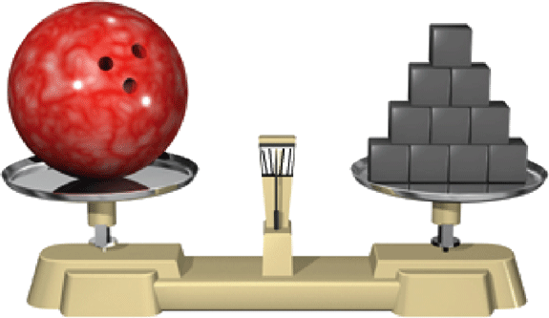
Matter has mass and volume.
1.1
matter
mass
weight
volume
Mass is a measure of how much matter an object contains.
CHAPTER
RESOURCES
SIMULATION
CLASSZONE.COM
Compare weights on different planets.
SECTION
OUTLINE

Slide 15
Chapter 1 Notes
Volume is a measure of the space that matter occupies
Volume – amount of space that matter in an object occupies
V = length * width * height
Or water displacement

Slide 16
Matter has mass and volume.
1.1
matter
mass
weight
volume
CHAPTER
RESOURCES
Volume is the measure of the amount of space matter occupies.
SECTION
OUTLINE

Slide 17
Warm-up (9-16-15)
Decide if these statements are true. If not, correct them
Substances you can see are matter, but substances you cannot see are not matter
Mass and weight are the same thing.
Formulas can be used to calculate the volume of many solids with a regular shape.
Notes:
All substances are matter
Mass and weight are not the same thing
Yes, formulas can be used to calculate the volume of many solids with regular shape

Slide 18
Outline for the Day
Objectives
Chapter 1 reading / notes

Slide 19
Objectives
Students will
Identify the smallest particles of matter
Describe how atoms combine into molecules
Describe how atoms and molecules move
Use modeling to draw conclusions about atoms and their masses

Slide 20
Chapter 1 Notes
Matter is made of atoms
Atoms are extremely small
Atom – the smallest basic unit of matter
Atomic theory of matter
5th century BC Greek philosophers proposed the idea
Molecule – when two or more atoms bond together or combine
Can be made of atoms that are alike or that are different
Can be made of different numbers of atoms
Atoms and molecules are always in motion

Slide 21
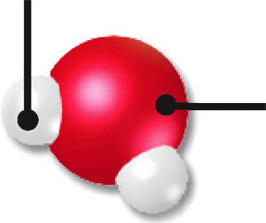
Matter is made of atoms.
1.2
An atom is the smallest basic unit of matter.
atom
Two or more atoms bonded together form a molecule.
molecule
Atoms and molecules are always in motion.
hydrogen
oxygen
CHAPTER
RESOURCES
water
SECTION
OUTLINE

Slide 22
What happens when substances are mixed?
Procedure
Observe and describe a teaspoon of cornstarch and a teaspoon of water
Mix the two substances together in the cup
Observe and describe the result.
What do you think?
After you mixed the substances, could you still see each substance?
How was the new substance different from the original substances?
Notes:
Materials:
Cornstarch
Water
Small cup
spoon

Slide 23
What Happens When Substances are Mixed?

Slide 24
Chapter 1 Notes
Matter combines to form different substances
Matter can be pure or mixed
Element: a substance that contains only a single type of atom.
Number of atoms is not important. All atoms must be of the same type
Compound: substance that consists of two or more different types of atoms bonded together
Mixture: a combination of different substances that remain the same individual substances and can be separated by physical means
Fruit salad

Slide 25
Warm Up (9-17-15)
Match each definition with the correct term
Definition | Term
The smallest basic unit of matter | Matter Volume Atom Weight molecule
A particle made when two or more atoms combine
Anything that has mass and takes up space

Slide 26
Objectives
Students will
Describe how pure and mixed matter are different
Explain how atoms and elements are related
Describe how atoms form compounds
Observe and compare in an experiment the properties of individual substances with the properties of mixtures.

Slide 27
Why do I care?
Everything that has mass and takes up space is matter.

Slide 28
Pouring Gases
Predict:
(Write a prediction of what you think will happen)
Observe:
(What do you see, what do you notice?)
Explain:
(Why did this happen? What evidence do you have that helps you explain what just happened?)

Slide 29
Pouring Gases
Explain

Slide 30
What’s the big idea?
Everything that has mass and takes up space is matter.
Matter has mass and volume
Matter is made of atoms
Matter combines to form different substances
Matter exists in different physical states

Slide 31
Warm-up (9-18-15)
Are most of the substances around you pure or mixed?
What is the difference between a pure substance and a mixed substance?
Notes:
Most are mixed
A pure substance has only one type of atom or molecule, while a mixed substance contains two or more different substances

Slide 32
Outline for the Day
Objectives
How well do oil and water mix?
Notes

Slide 33
Objectives
Students will
Describe how pure and mixed matter are different
Explain how atoms and elements are related
Describe how atoms form compounds
Observe and compare in an experiment the properties of individual substances with the properties of mixtures.
Students will
Describe the different states of matter
Describe how the different states of matter behave
Experiment with the behavior of different liquids

Slide 34
How well do oil and water mix?
Procedure
Add a few drops of food coloring to the water in the beaker. Swirl the water around in the beaker until the water is evenly colored throughout.
Pour the colored water from the beaker into the jar until the jar is about one-fourth full
Add the same amount of vegetable oil to the jar. Screw the lid tightly on the jar
Carefully shake the jar several times with your hand over the cover, then set it on the table. Observe and record what happens to the liquids in the jar.
Turn the jar upside down and hold it that way. Observe what happens to the liquids and record your observations

Slide 35
How well do oil and water mix?
What do you think?
Does water mix with food coloring? What evidence supports your answer?
Do water and oil mix? What evidence supports your answer?
What happened when you turned the jar upside down?
Based on your observations, what can you infer about the ability of different liquids to mix?
Challenge
To clean greasy dishes, you add soap to the dishwater. Try adding soap to your mixture. What does the soap do?

Slide 36
Mixtures vs. Compounds
Substances in mixtures remain the same substances
Compounds are new substances formed by atoms that bond together
Mixtures can be separated by physical means
Compounds can be separated only by breaking the bonds between atoms
Proportions of different substances in a mixture can vary throughout the mixture or from mixture to mixture
Proportions of different substances in a compound are fixed because the type and number of atoms that make up a basic unit of the compound are always the same

Slide 37
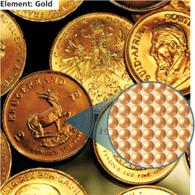
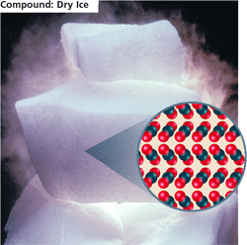
Matter combines to form different substances.
1.3
Matter can be pure, such as an element (gold), or a compound (water).
element
compound
mixture
Element: Gold
Compound: Dry Ice
CHAPTER
RESOURCES
SECTION
OUTLINE

Slide 38
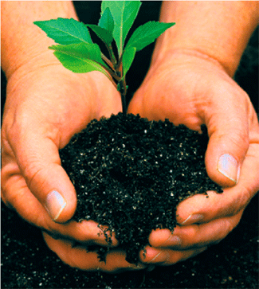
Matter combines to form different substances.
1.3
Matter can be pure, such as an element (gold), or a compound (water).
element
Matter can be a mixture. Mixtures contain two or more pure substances.
compound
mixture
CHAPTER
RESOURCES
SECTION
OUTLINE

Slide 39
Parts of mixtures can be the same or different throughout
Heterogeneous mixture – mixtures that have different properties in different areas of the mixture
Homogeneous mixture – substances are evenly spread throughout the mixture

Slide 40
What’s the big idea?
Everything that has mass and takes up space is matter.
Matter has mass and volume
Matter is made of atoms
Matter combines to form different substances
Matter exists in different physical states

Slide 41
Warm-up (9-21-15)
What is one interesting thing about liquids?
What is one thing about gases that is different from liquids?

Slide 42
Outline for the Day
Objectives
Bill Nye States of Matter
Matter and Energy

Slide 43
Objectives
To explore states of matter as well as phase changes.

Slide 44
Video – Atoms and Molecules
During the video:
Separate sheet of paper
10 questions or interesting facts (complete sentences)
When finished we will be writing a summary of what you learned about atoms and molecules

Slide 45
Bill Nye States of Matter
https://www.youtube.com/watch?v=45YNZjYfHb4
During the video, get out a separate piece of paper.
You need to write down 5 questions / things that you found interesting.
After the video is over, you need to write a summary in your own words of what the video was about.

Slide 46
Changing the States of Matter
We will be watching a simulation of what happens as matter changes states.
You are to write down all of your observations, I will give you more detail once you see the beginning of the simulation

Slide 47
States of Matter and Phase Changes
http://phet.colorado.edu/en/simulation/states-of-matter

Slide 48
Warm-up (9-22-15)
What are some general statements that can be made about the motion of atoms when they are either heated or cooled?

Slide 49
Outline for the Day
Objectives
States of matter notes

Slide 50
Objectives
To explore states of matter and their properties.

Slide 51
Matter exists in different physical states
Particle arrangement and motion determine the state of matter
States of matter – different forms in which matter can exist
Solid, liquid, gas, plasma

Slide 52
Solid – substance that has a fixed volume and fixed shape
Particles are close together
Particles in a solid can vibrate
Liquid – has a fixed volume but does not have a fixed shape
Takes the shape of its container, particles are attracted to one another, and close. Can move from one place to another
Gas – no fixed volume or shape. Can take both shape and volume of its container

Slide 53
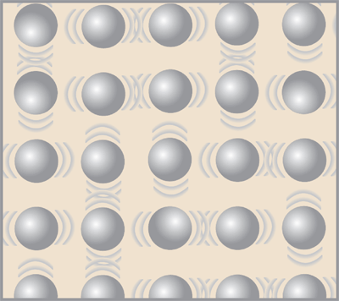
Matter exists in different physical states.
1.4
Solids have a fixed volume and a fixed shape.
states of matter
solid
liquid
gas
CHAPTER
RESOURCES
SECTION
OUTLINE

Slide 54
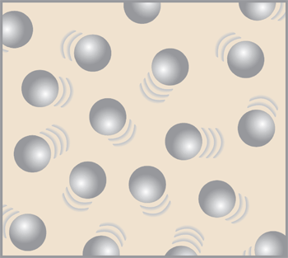
Matter exists in different physical states.
1.4
Solids have a fixed volume and a fixed shape.
states of matter
Liquids have a fixed volume but no fixed shape.
solid
liquid
gas
CHAPTER
RESOURCES
SECTION
OUTLINE

Slide 55
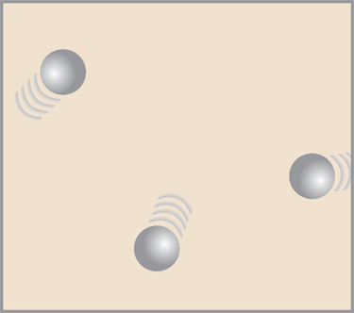
Matter exists in different physical states.
1.4
Solids have a fixed volume and a fixed shape.
states of matter
Liquids have a fixed volume but no fixed shape.
Gases have no fixed volume and no fixed shape.
solid
liquid
gas
CHAPTER
RESOURCES
SECTION
OUTLINE

Slide 56
Matter exists in different physical states.
1.4
Solids have a fixed volume and a fixed shape.
states of matter
Liquids have a fixed volume but no fixed shape.
Gases have no fixed volume and no fixed shape.
solid
liquid
gas
SIMULATION
CLASSZONE.COM
Explore the behavior of a gas.
CHAPTER
RESOURCES
SECTION
OUTLINE

Slide 57
Work Time
This is your time to work on your study guide and/or your vocab!
Use it wisely

Slide 58
Warm-up (9-23-15)
What are three phases of matter?
What does absolute zero mean?

Slide 59
Outline for the Day
Objectives
Phases of Matter Notes
Simulation
Properties of Gases
Matter and Energy

Slide 60
Objectives
To explain the 4 phases of matter and the properties of each phase
To explore what happens when changing pressure and temperature of atoms

Slide 61
Warm-up (9-24-15)
Summarize what you’ve learned about the states of matter and their properties.
Write down a question that you have about the properties of plasmas.

Slide 62
Outline for the Day
Objectives
Phases of Matter Notes
Simulation
Properties of Gases
Matter and Energy

Slide 63
Objectives
To explain the 4 phases of matter and the properties of each phase
To explore what happens when changing pressure and temperature of atoms

Slide 64
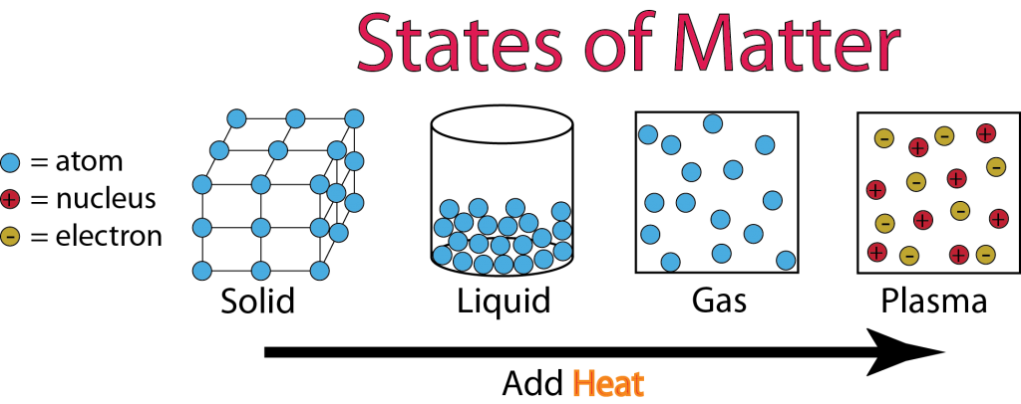
Phases of Matter
Solid
Liquid
Gas
Plasma

Slide 65
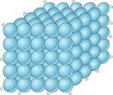
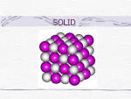
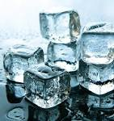
Solid

Slide 66
Properties of Solids
Fixed volume and fixed shape
Particles are close together and usually form a rectangular pattern
Each particle is attached to several others, so individual particles cannot move from one location to another
This makes the solid rigid

Slide 67
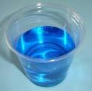
Liquid

Slide 68
Properties of Liquids
Fixed volume but no fixed shape
Take on the shape of the container they are in
Particles are attracted to one another and are close together
Particles are not fixed in place and can move from one place to another

Slide 69
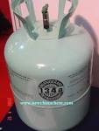
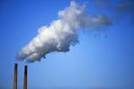
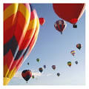
Gas

Slide 70
Properties of Gases
No fixed volume or shape
Can take on both the shape and the volume of a container
Particles are not close to each other and can move easily in any direction
Much more space between gas particles than there is in solids or liquids
Space between particles can increase or decrease with changes in temperature and pressure

Slide 71
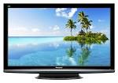
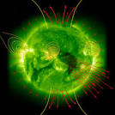
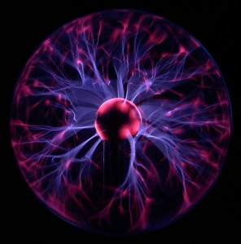
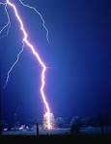
Plasma
Notes:
- The glowing “gas” (actually plasma!) inside neon signs and fluorescent lights. - The glowing parts of a plasma TV. - The exhaust of big rockets. - Lightning. - The northern and southern lights. - The solar wind and space weather. - The Sun and all the stars. - The stuff inside a fusion reactor.

Slide 72
Properties of Plasma
Made of charged particles
Every particle can interact with every other particle, even over long distances
Can form waves and complex motion
99% of the universe is made of plasmas

Slide 73
Warm-up (9-28-15)
How is an object’s weight affected by gravity? (Think of how much we weighed on different planets)
How is an object’s mass affected by gravity?

Slide 74
Outline for the Day
Objectives
Unifying Principle
Gas Behavior
Mass and Volume Lab Prep
Study Guide and Vocab Work Time or Begin Mass and Volume Lab

Slide 75
Objectives
To determine characteristics of the behavior of gases
To demonstrate that gas and liquid are matter because they take up space

Slide 76
Unifying Principle
Matter changes form and moves from place to place.
*Read* page xvi in Matter and Energy mini book
Close your eyes. Listen to the scenario. Write down where the matter went. Think about what happened to the water, think about what happened to the rock.
Notes:
All material from McDougal Littell’s Physical Science book
What it Means:
Matter is made of tiny particles called atoms. Atoms are constantly moving and combining with one another. All changes in matter are the result of atoms moving and combining in different ways.
Matter Changes and Moves
You can look at water to see how matter changes and moves. A block of ice is hard like a rock. Leave the ice out in the sunlight, and it changes into a puddle of water. That puddle of water can eventually change into water vapor and disappear into the air. The water vapor in the air can become raindrops, which may fall on rocks, causing them to weather and wear away. The water that flows in rivers and streams picks up tiny bits of rock and carries thme from one shore to another. Understanding how the world works requires an understanding of how matter changes and moves.
Matter is Conserved
No matter was lost in any of the changes described above. The ice turned to water because its molecules began to move more quickly as they got warmer. The bits of rock carried away by the flowing river were not gone forever. They simply ended up farther down the river. The puddles of rainwater didn’t really disappear, their molecules slowly mixed with molecules in the air.
Under ordinary conditions, when matter changes form, no matter is created or destroyed. The water created by melting ice has the same mass as the ice did. If you could measure the water vapor that mixes with the air, you would find it had the same mass as the water in the puddle did.
Why it’s important
Understanding how mass if conserved when matter changes form has helped scientists to
Describe changes they see in the world
Predict what will happen when two substances are mixed
Explain where matter goes when it seems to disappear.

Slide 77
Properties of Gases
We will be watching a simulation of what happens as matter changes states.
You are to write down all of your observations, I will give you more detail once you see the beginning of the simulation

Slide 78
Properties of Gases
http://phet.colorado.edu/en/simulation/gas-properties

Slide 79
Density Tower
Write down observations as each layer is added
Write down what you can conclude about the density of water based on what happened in the tower when the water was added.

Slide 80
Density Simulation
Predict:
Observe:
Explain:

Slide 81
Explain

Slide 82
Behavior of Gases
When temperature is held constant…
if pressure increases then volume decreases
When volume is held constant…
if temperature increases then pressure increases
When pressure is held constant…
if temperature increases then volume increases

Slide 83
Warm-up (9-29-15)
Explain what density is and how you think density can affect liquids.

Slide 84
Outline for the Day
Objectives
Density simulation pHet
Density Tower – Harry Potter Potions

Slide 85
Objectives
Students will:
Identify how liquids with different densities behave
Describe how density is measured and determined

Slide 86
Density
http://phet.colorado.edu/en/simulation/density

Slide 87
Discussion
Mass and Volume
If gram was the standard unit of measure for mass…
What is the standard unit of measure for weight?
Kilogram

Slide 88
Hmmm… What’s this all about?
Matter has both mass and volume. However, matter also has a property known as density.

Slide 89
Density
What is density?
Mass / Volume
Compactness
How much mass there is per unit of volume
How much stuff can we cram into a tiny bit of space

Slide 90
Density Tower
Predict:
Observe:
Explain:

Slide 91
Explain:

Slide 92
Explain

Slide 93
Density Tower
If you were absent, set up your notebook and watch the demonstration with this link
http://www.youtube.com/watch?v=-CDkJuo_LYs

Slide 94
Can Crusher
Predict:
Observe: (Draw a picture, as well as describe what happened)
Explain:

Slide 95
Can Crusher
http://www.stevespanglerscience.com/lab/experiments/incredible-can-crusher
If you’re gone, watch the following link after setting up your notebook
https://www.youtube.com/watch?v=QVayky_b-6U

Slide 96
Explain:
Notes:
From Steve Spangler Science:
Before heating, the can was filled with water and air. By boiling the water, the water changed states from a liquid to a gas. This gas is called water vapor. The water vapor pushed the air that was originally inside the can out into the atmosphere. When the can was turned upside down and placed in the water, the water vapor condensed and turned back into the water. Water molecules in the liquid state are many times closer together than molecules in the gas state. All of the water vapor that filled up the inside of the can turned into only a drop or two of liquid, which took up much less space.
This small amount of water cannot exert much pressure on the inside walls of the can, so the pressure of the air pushing from the outside of the can is great enough to crush it. The sudden collapsing of an object toward its center is called an implosion. Nature wants things to be in a state of equilibrium or balance. To make the internal pressure of the can balance with the external pressure on the can, the can implodes. Hey, air pressure is powerful!
One more thing... if you watch very closely when you turn the can upside down, you'll see that the cold water in the bowl shoots up into the can. This is similar to what happens when you drink from a straw. Though we say we are "sucking" liquid up through the straw, we really aren't. Outside air pressure is pushing down on the surface of the liquid. When you reduce the pressure in your mouth (that sucking action) the outside pressure is greater than the pressure inside your mouth and the soda shoots through the straw and into our mouths. The same thing is true with the can. The force applied downward into the cold water pushes the water up into the can. To put it simply, science doesn't suck... it just pushes and pulls.
See more at: http://www.stevespanglerscience.com/lab/experiments/incredible-can-crusher#sthash.RCLAcWFL.dpuf

Slide 97
Explain:

Slide 98
Galileo’s Thermometer
https://www.youtube.com/watch?v=tawnlvuR5x0

Slide 99
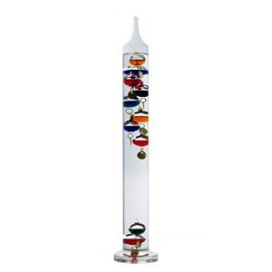
Galileo’s Thermometer
temperature of the air outside the thermometer changes, so does the temperature of the water inside.
When temp. changes, what is happening to molecules?
Expanding or contracting (changing density)
So, at any given density, some of the bubbles will float and others will sink.
The bubble that sinks the most indicates the approximate current temperature.
Notes:
http://www.howstuffworks.com/question663.htm

Slide 100
Review!
What characteristic of CO2 is shared with liquids that allows you to classify it as a liquid?
What is Galileo’s thermometer? And how does it work?

Slide 101
Warm-up (9-30-15)
Explain what you think buoyancy is. Include an example of where buoyancy is found.

Slide 102
Outline for the Day
Objectives
Buyoancy

Slide 103
Objectives
To explore the concept of buoyancy and describe how this force affects matter.

Slide 104
Galileo’s Thermometer
temperature of the air outside the thermometer changes, so does the temperature of the water inside.
When temp. changes, what is happening to molecules?
Expanding or contracting (changing density)
So, at any given density, some of the bubbles will float and others will sink.
The bubble that sinks the most indicates the approximate current temperature.
Notes:
http://www.howstuffworks.com/question663.htm

Slide 105
Review!
What characteristic of CO2 is shared with liquids that allows you to classify it as a liquid?
What is Galileo’s thermometer? And how does it work?

Slide 106
Buoyancy

Slide 107
Story Time!!
https://www.youtube.com/watch?v=KMNwXUCXLdk
http://www.math.nyu.edu/~crorres/Archimedes/Crown/CrownIntro.html
Notes:
http://www.cpet.ufl.edu/wp-content/uploads/2013/03/Creating-‘Buoyancy-Boats’-Lesson-Plan-Applying-Archimedes-Principle.pdf

Slide 108
Buoyancy
http://www2.dusd.net/staff/jklingelsmith/JKling/NOTES_files/Buoyancy%20NotesPDF.pdf

Slide 109
Float Your Boat - Buoyancy

Slide 110
Introduce Float Your Boat
Lab Notebook Set Up
Prediction
Read through Directions

Slide 111
Warm-up (10-1-15)
What does it mean if something is dense?
Density describes what about an object?

Slide 112
Outline for the Day
Objectives
Float Your Boat

Slide 113
Objectives
To explore and explain the concept of density and to construct a density tower
To explore the concept of density using a simulation

Slide 114
Float Your Boat

Slide 115
Rock Candy Experiment Prep.
Read through the procedures
http://www.stevespanglerscience.com/lab/experiments/homemade-rock-candy#

Slide 116
Warm-up (10-2-15)
Can density be applied to solids and gases, or is it only a property of liquids? Explain your answer.
How does volume affect an object if it is placed in a liquid?

Slide 117
Outline for the Day
Objectives
Buoyancy Lab

Slide 118
Objectives
To demonstrate the concept of buoyancy
Construct a boat that will hold the largest number of pennies and will counter the effects of gravity

Slide 119
Rock Candy Experiment Prep.
Read through the procedures
http://www.stevespanglerscience.com/lab/experiments/homemade-rock-candy#

Slide 120
Warm-up (10-5-15)
Explain some observations you have so far about the float your boat lab.
(Think about the relationship between volume of your boat and how many pennies it holds.)

Slide 121
Outline for the Day
Objectives
Float your boat lab
Chapter 1 Review Game

Slide 122
Objectives
To demonstrate phase changes of matter by creating rock candy.

Slide 124
Buoyancy Lab Questions
7.Analyze your graphs
What do your results tell you about the relationship between buoyancy (amount of weight a boat can support) and volume of the boat hull?
The density of the hulls right before sinking should roughly be the same as the density of water.

Slide 125
Chapter 1 Review
Any questions that you would like to go over?
Study Guide and Vocabulary Work time
They are due tomorrow!!!

Slide 126
Warm up (10-6-15)
Explain how buoyancy affected the boat in your lab. Explain why your boat was able to hold the number of pennies that it could.

Slide 127
Outline
Objectives
Review for test
Study guide work time
Chapter 1 Test

Slide 128
Objectives
Demonstrate knowledge of matter and its various states by completing the chapter 1 Test.

Slide 129
Test
No talking.
Write your answers only on the answer sheet.
DO NOT WRITE ON THE TEST

Slide 130
Warm up (10-7-15)
Write down everything that you can remember about Chapter 1 (think about states of matter, properties of gases, think about density, think about atoms, mixtures, compounds)

Slide 131
Outline
Objectives
Chapter 1 Test

Slide 132
Objectives
Demonstrate knowledge of matter and its various states by completing the chapter 1 Test.

Slide 133
Test
No talking.
Write your answers only on the answer sheet.
DO NOT WRITE ON THE TEST

