Slide 1
Chapter 6 and 7
Meiosis and Mendel
Extending Mendelian Genetics
Notes:
All information for this powerpoint was retrieved from McDougal Littell Biology book, Stephen Nowicki published by McDougal Littell which is a Houghton Mifflin Company – Information was also gathered from the power presentations CD for Holt McDougal Biology
Other information for each of the slides might be linked in the comment section of the slides themselves
Some notes for these chapters were retrieved from the McDougal Littell power presentation CD from Holt McDougal

Slide 2
Warm up (2-23-16)
Explain what you remember from middle school about genetics
(Think about phenotype and genotype, think about Punnett Squares, think about Mendel, and gene inheritance.)

Slide 3
Outline
Objectives
Chromosomes and Meiosis
Review genetics and what was discussed in middle school

Slide 4
Objectives
Students will be able to identify the difference between sex cells and somatic cells and explain why these two types of cells are different.
Students will be able to identify the number of chromosomes present in sex cells versus somatic cells.

Slide 5
Warm up (2-24-16)
Explain the difference between diploid and haploid and what those terms mean.

Slide 6
Outline
Objectives
Make a baby worksheet

Slide 7
Objectives
Students will be able to identify the difference between sex cells and somatic cells and explain why these two types of cells are different.
Students will be able to identify the number of chromosomes present in sex cells versus somatic cells.

Slide 8
Make a baby worksheet
Pick a partner and walk your way through the worksheet.
This will give us an introduction to genetics and how gene inheritance works.

Slide 9
Warm up (2-25-16)
How many cells go into the process of meiosis? How many cells come out of the process of meiosis?
Please explain how many chromosomes are in the cells going into meiosis and how many chromosomes are in the cells coming out of meiosis.

Slide 10
Outline
Objectives
Process of Meiosis notes
Meiosis Drawings

Slide 11
Objectives
Students will be able to identify the difference between sex cells and somatic cells and explain why these two types of cells are different.
Students will be able to identify the steps in meiosis and explain what is occurring to the chromosomes at each step

Slide 12
Warm up (2-26-16)
What are the phases of meiosis? Please be specific and indicate which division those phases are associated with.

Slide 13
Outline
Objectives
Finish Meiosis notes
6.1 and 6.2 section review questions

Slide 14
Objectives
Students will be able to identify the difference between sex cells and somatic cells and explain why these two types of cells are different.
Students will be able to identify the steps in meiosis and explain what is occurring to the chromosomes at each step

Slide 15
Warm up (2-29-16)
Explain what genetics is and how specific traits can be determined for organisms.

Slide 16
Outline
Objectives
Read 6.3 Mendel and Genetics
Heredity
video
Mendel and Heredity

Slide 17
Objectives
Students will be able to identify the difference between sex cells and somatic cells and explain why these two types of cells are different.
Students will be able to identify the steps in meiosis and explain what is occurring to the chromosomes at each step

Slide 18
6.1 Notes
Gametes have half the number of chromosomes that body cells have
There are body cells and gametes
Somatic cells: body cells, make up most of your body tissues and organs
Gametes: sex cells, egg in the female and sperm in the male

Slide 19
Your body cells have autosomes and sex chromosomes
Homologous chromosomes: 2 chromosomes
“having the same structure”
One from mother, one from father
Have copies of the same genes although the copies may be different
Numbered from the largest chromosome to the smallest
Autosomes: chromosomes numbers 1-22
Chromosomes contain genes for characteristics not directly related to the sex of the organism

Slide 20
Your body cells have autosomes and sex chromosomes
Sex chromosomes: directly control the development of sexual characteristics
All mammals are based on the X and Y system
This is the 23rd pair of chromosomes
X and Y are paired together but they are not homologous
X chromosome is larger, contains many genes, even some unrelated to sexual characteristics
Y chromosome is smallest, carries fewest genes, contains genes in direct development of male traits

Slide 21
Body cells are diploid, Gametes are haploid
Sexual Reproduction: fusion of two gametes which results in the production of offspring that are a genetic mixture of both parents
Fertilization: actual fusion of egg and sperm
Diploid: a cell has two copies of each chromosome
One from mother, one from father
2n
In humans, diploid number is 46
***What would the haploid number be?****

Slide 22
Body cells are diploid, Gametes are haploid
Haploid: a cell has only one copy of each chromosome
n
Human gametes
Maintaining the correct number of chromosomes is important to the survival of all organisms
Typically change in number is harmful, but on occasion increasing number of sets can give rise to new species

Slide 23
Warm up (3-1-16)
Explain Mendel’s experiments in your own words. Explain why his work was important.

Slide 24
Outline
Objectives
Mendel and Heredity
Notes 6.3
Read 6.4
Notes 6.4
Intro 6.5

Slide 25
Objectives
Students will be able to identify the difference between sex cells and somatic cells and explain why these two types of cells are different.
Students will be able to identify the steps in meiosis and explain what is occurring to the chromosomes at each step

Slide 26
Meiosis
A form of nuclear division that divides a diploid cell into haploid cells
Essential for sexual reproduction
Occurs in germ cells to produce gametes
“reduction division” – reduce chromosome number by half
DNA is copied once but divided twice
Genetically unique haploid cells form from a diploid cell

Slide 27
Process of Meiosis

Slide 28
Meiosis Video
https://www.khanacademy.org/science/biology/cellular-molecular-biology/new-topic-2014-06-18T18:00:45.081Z/v/phases-of-meiosis
https://www.youtube.com/watch?v=16enC385R0w

Slide 29
Meiosis I

Slide 30
Prophase I

Slide 31
Metaphase I

Slide 32
Anaphase I

Slide 33
Telophase I

Slide 34
Cytokinesis

Slide 35
Meiosis II

Slide 36
Prophase II

Slide 37
Metaphase II

Slide 38
Anaphase II

Slide 39
Telophase II

Slide 40
Cytokinesis

Slide 41
Meiosis Drawings and Notes on the Phases
Take a few minutes and use your paper to draw the phases of meiosis.
You may use the book if you need to
We will be taking notes on the lines next to the drawings so please try to keep your drawings small enough to not cover the lines.

Slide 42
Warm up (3-2-16)
What is the law of segregation?
What are traits, genes, and alleles?
Use these terms and explain how each of these terms is involved in genetics.

Slide 43
Outline
Objectives
6.5 Notes
Punnett Square practice - Bunny game
Chapter 6.1-6.3 Quiz

Slide 44
Objectives
Students will be able to identify the difference between sex cells and somatic cells and explain why these two types of cells are different.
Students will be able to identify the steps in meiosis and explain what is occurring to the chromosomes at each step

Slide 45
Meiosis
A form of nuclear division that divides a diploid cell into haploid cells
Essential for sexual reproduction
Occurs in germ cells to produce gametes
“reduction division” – reduce chromosome number by half
DNA is copied once but divided twice
Genetically unique haploid cells form from a diploid cell

Slide 46
Meiosis Video
https://www.khanacademy.org/science/biology/cellular-molecular-biology/new-topic-2014-06-18T18:00:45.081Z/v/phases-of-meiosis
https://www.youtube.com/watch?v=16enC385R0w

Slide 47
6.3 Notes - Mendel and Heredity
Mendel’s research showed that traits are inherited as discrete units
Mendel laid the groundwork for genetics
Traits: distinguishing characteristics that are inherited
Genetics: study of biological inheritance
Mendel’s Data revealed patterns of inheritance
Purebred: genetically uniform
Mendel chose 7 traits to look at
Mendel controlled pollination by removing stamens

Slide 48
KEY CONCEPT Mendel’s research showed that traits are inherited as discrete units.

Slide 49
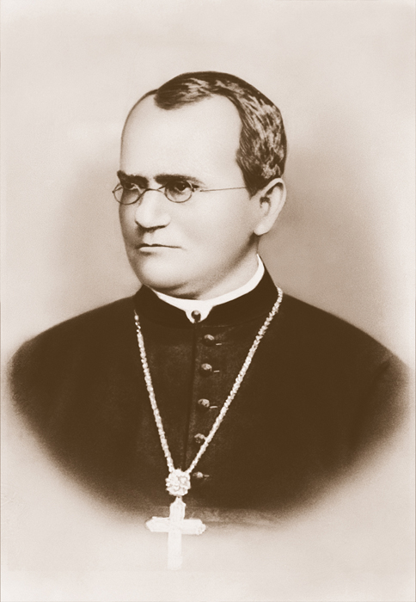
Mendel laid the groundwork for genetics.
Traits are distinguishing characteristics that are inherited.
Genetics is the study of biological inheritance patterns and variation.
Gregor Mendel showed that traits are inherited as discrete units.
Many in Mendel’s day thought traits were blended.

Slide 50
Warm up (3-3-16)
Perform the following cross by using a Punnett Square: BB x Bb

Slide 51
Outline
Objectives
I do - we do - you do Punnett Square practice
Punnett Square worksheet

Slide 52
Objectives
Students will be able to identify the difference between sex cells and somatic cells and explain why these two types of cells are different.
Students will be able to identify the steps in meiosis and explain what is occurring to the chromosomes at each step

Slide 53
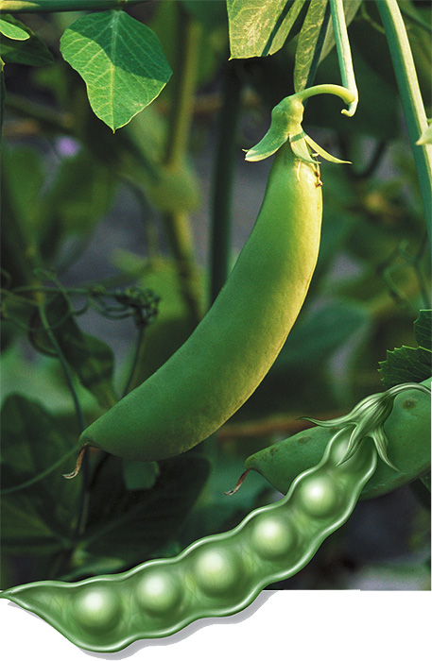
Mendel’s data revealed patterns of inheritance.
Mendel made three key decisions in his experiments.
use of purebred plants
control over breeding
observation of seven “either-or” traits

Slide 54
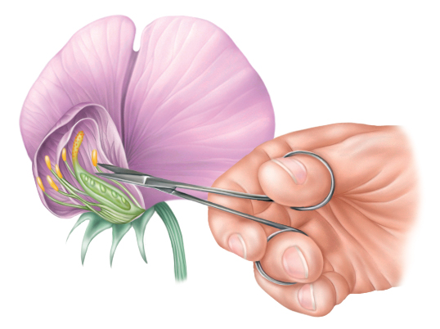
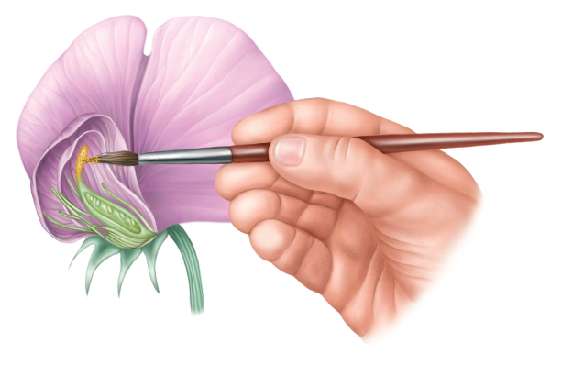
Mendel used pollen to fertilize selected pea plants.
P generation crossed to produce F₁ generation
interrupted the self-pollination process by removing male flower parts
Mendel controlled the
fertilization of his pea plants
by removing the male parts,
or stamens.
He then fertilized the female
part, or pistil, with pollen from
a different pea plant.

Slide 55
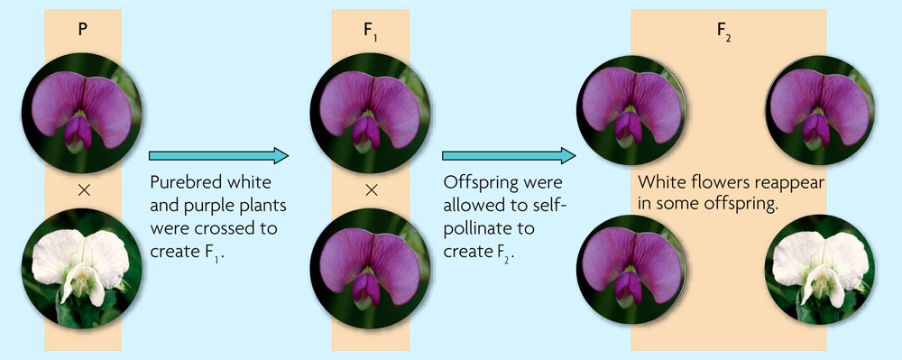
Mendel allowed the resulting plants to self-pollinate.
Among the F₁ generation, all plants had purple flowers
F₁ plants are all heterozygous
Among the F₂ generation, some plants had purple flowers and some had white

Slide 56
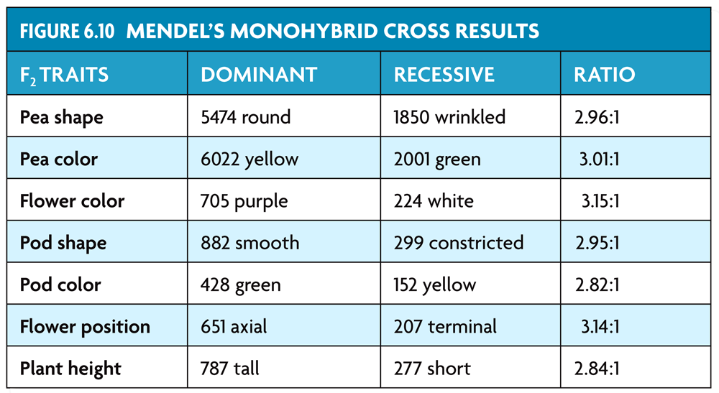
Mendel observed patterns in the first and second generations of his crosses.

Slide 57
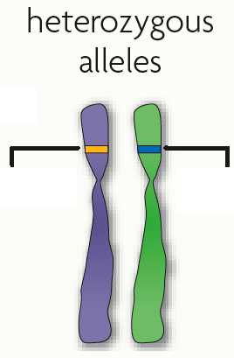
Mendel drew three important conclusions.
Traits are inherited as discrete units.
Organisms inherit two copies of each gene, one from each parent.
The two copies segregate during gamete formation.
The last two conclusions are called the law of segregation.
purple
white

Slide 58
Warm up (3-4-16)
Explain the process of using a Punnett Square. Can a Punnett Square be larger than 4 squares? If so, explain how.

Slide 59
Outline
Objectives
Reading Ch. 6.6
Notes 6.5 (?) and 6.6
Chapter 6 Quizzes

Slide 60
Objectives
Students will be able to identify the difference between sex cells and somatic cells and explain why these two types of cells are different.
Students will be able to identify the steps in meiosis and explain what is occurring to the chromosomes at each step

Slide 61
6.4 Notes

Slide 62
KEY CONCEPT Genes encode proteins that produce a diverse range of traits.

Slide 63
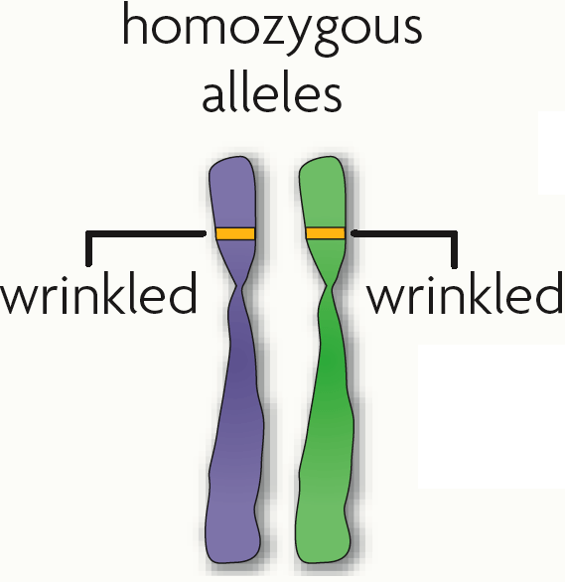
The same gene can have many versions.
A gene is a piece of DNA that directs a cell to make a certain protein.
Each gene has a locus, a specific position on a pair of homologous chromosomes.

Slide 64
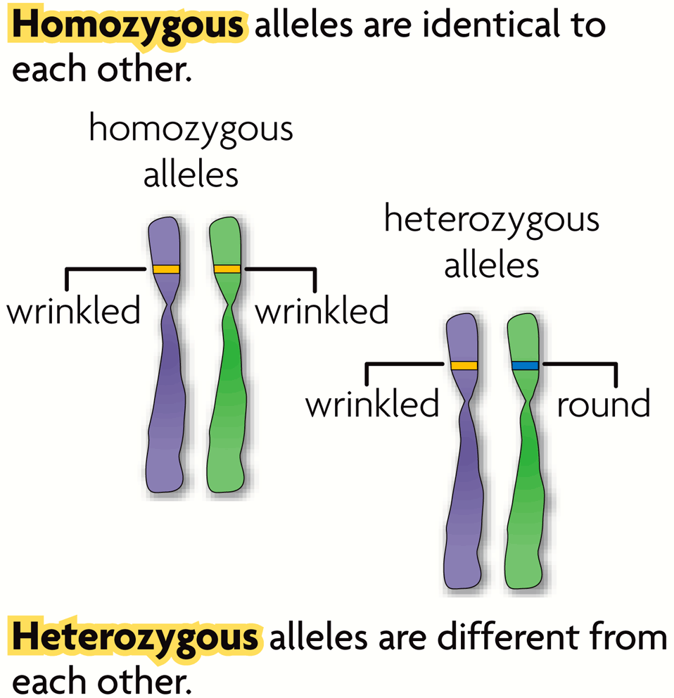
An allele is any alternative form of a gene occurring at a specific locus on a chromosome.
Each parent donates one allele for every gene.
Homozygous describes two alleles that are the same at a specific locus.
Heterozygous describes two alleles that are different at a specific locus.

Slide 65
Genes influence the development of traits.
All of an organism’s genetic material is called the genome.
A genotype refers to the makeup of a specific set of genes.
A phenotype is the physical expression of a trait.

Slide 66
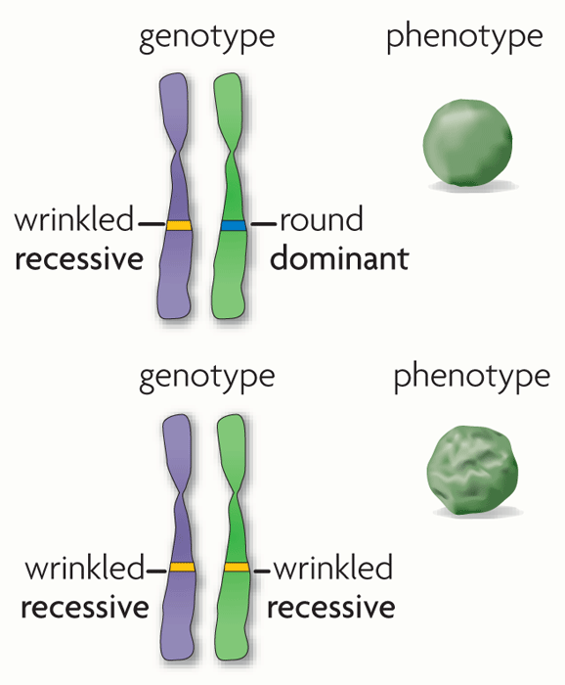
Alleles can be represented using letters.
A dominant allele is expressed as a phenotype when at least one allele is dominant.
A recessive allele is expressed as a phenotype only when two copies are present.
Dominant alleles are represented by uppercase letters; recessive alleles by lowercase letters.

Slide 67
Both homozygous dominant and heterozygous genotypes yield a dominant phenotype.
Most traits occur in a range and do not follow simple dominant-recessive patterns.

Slide 68
Warm up (3-7-16)
Explain what crossing over is and which stage of meiosis this process occurs in.

Slide 69
Outline
Objectives
6.6 Reading and Notes
Make a “baby” genetics project

Slide 70
Objectives
Students will be able to identify the difference between sex cells and somatic cells and explain why these two types of cells are different.
Students will be able to identify the steps in meiosis and explain what is occurring to the chromosomes at each step

Slide 71
Warm up (3-8-16)
Explain what causes traits to be passed down to offspring from the parents. (Use the words, traits, alleles, dominant, recessive, heterozygous, and homozygous in your answer.)

Slide 72
Outline
Objectives
Genetics Project – Offspring Creation
Mini partner quiz

Slide 73
Objectives
Students will be able to identify the difference between sex cells and somatic cells and explain why these two types of cells are different.
Students will be able to identify the steps in meiosis and explain what is occurring to the chromosomes at each step

Slide 74
Warm up (3-9-16)
Explain how phenotype is determined for genetic crosses. (Don’t forget to mention which alleles must be present for specific phenotypes to appear.)

Slide 75
Outline
Objectives
Chapter 7 Intro

Slide 76
Objectives
Describe how sexual reproduction creates unique gene combinations
Explain how crossing over during meiosis increases genetic diversity

Slide 77
Video: Genetics and Heredity
https://www.youtube.com/watch?v=NWqgZUnJdAY

Slide 78
Warm up (3-10-16)
What does it mean if there is codominance for a particular gene?

Slide 79
Outline
Objectives
Genetics video
Quick lab p. 185
Allele Combinations p. 188
Bunny Game!

Slide 80
Objectives
Describe how sexual reproduction creates unique gene combinations
Explain how crossing over during meiosis increases genetic diversity

Slide 81
Punnett Square Practice
Composition notebooks to the next page.
P. 185 in your books – Quick Lab
P. 188 in your books – Allele combinations and Punnett Squares

Slide 82
Punnett Square Practice
Bunny Game
http://vital.cs.ohiou.edu/steamwebsite/downloads/FurryFamily.swf

Slide 83
I do - We do - You do
Punnett Square Practice

Slide 84
Punnett Square Worksheet

Slide 85
Warm up (3-14-16)
Explain how sexual reproduction generates new allele combinations in offspring.

Slide 86
Outline
Objectives
Bunny Game!
6.5 and 6.6 Notes

Slide 87
Objectives
Describe how sexual reproduction creates unique gene combinations
Explain how crossing over during meiosis increases genetic diversity

Slide 88
6.5 Notes

Slide 89
KEY CONCEPT The inheritance of traits follows the rules of probability.

Slide 90
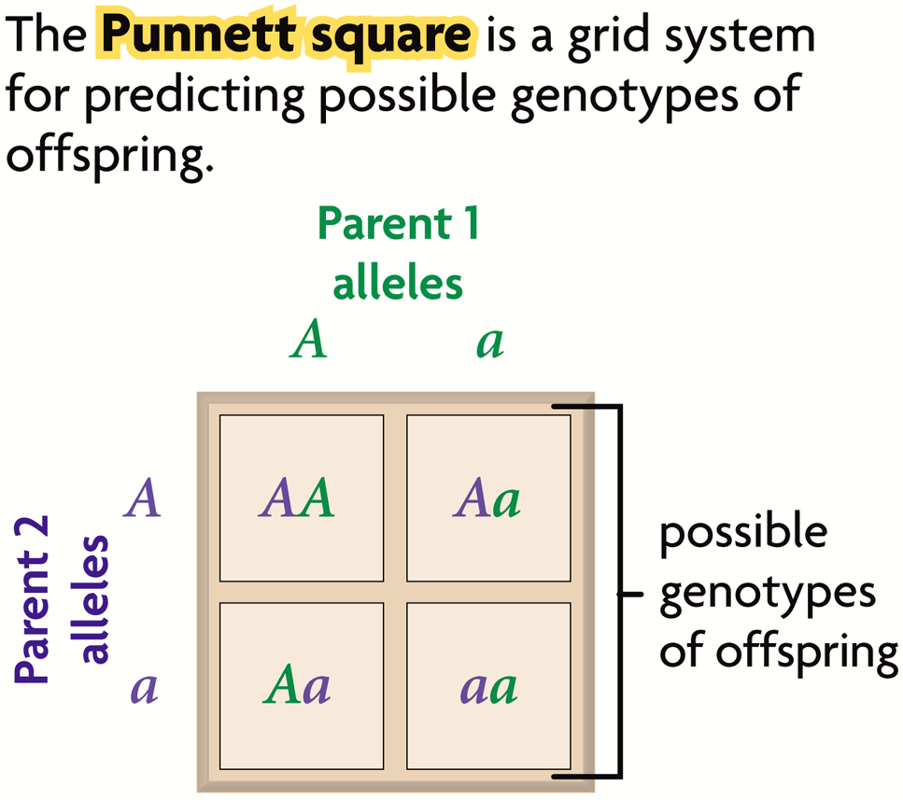
Punnett squares illustrate genetic crosses.
The Punnett square is a grid system for predicting all possible genotypes resulting from a cross.
The axes represent the possible gametes of each parent.
The boxes show the possible genotypes of the offspring.
The Punnett square yields the ratio of possible genotypes and phenotypes.

Slide 91
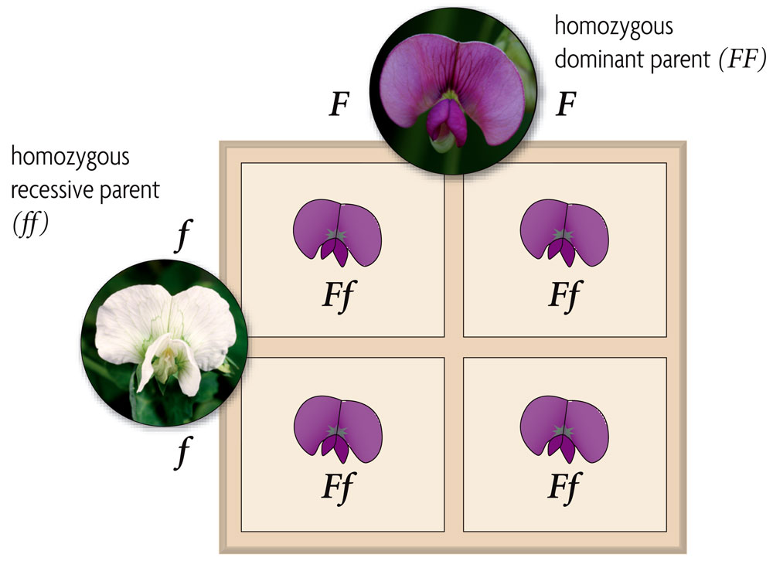
A monohybrid cross involves one trait.
Monohybrid crosses examine the inheritance of only one specific trait.
homozygous dominant-homozygous recessive: all heterozygous, all dominant

Slide 92
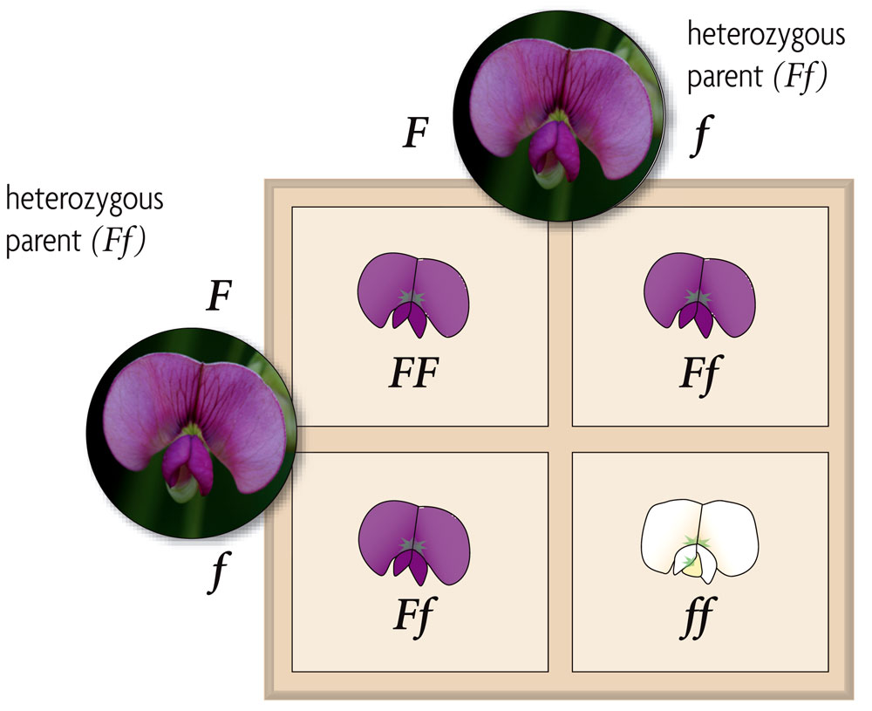
heterozygous-heterozygous—1:2:1 homozygous dominant: heterozygous:homozygous recessive; 3:1 dominant:recessive

Slide 93
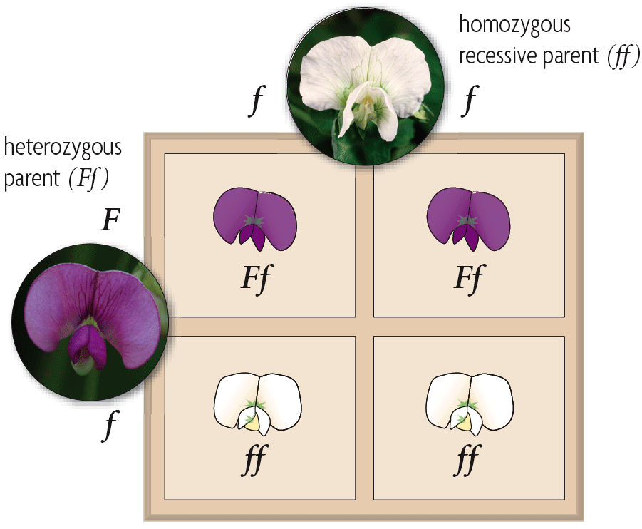
heterozygous-homozygous recessive—1:1 heterozygous:homozygous recessive; 1:1 dominant:recessive
A testcross is a cross between an organism with an unknown genotype and an organism with the recessive phenotype.

Slide 94
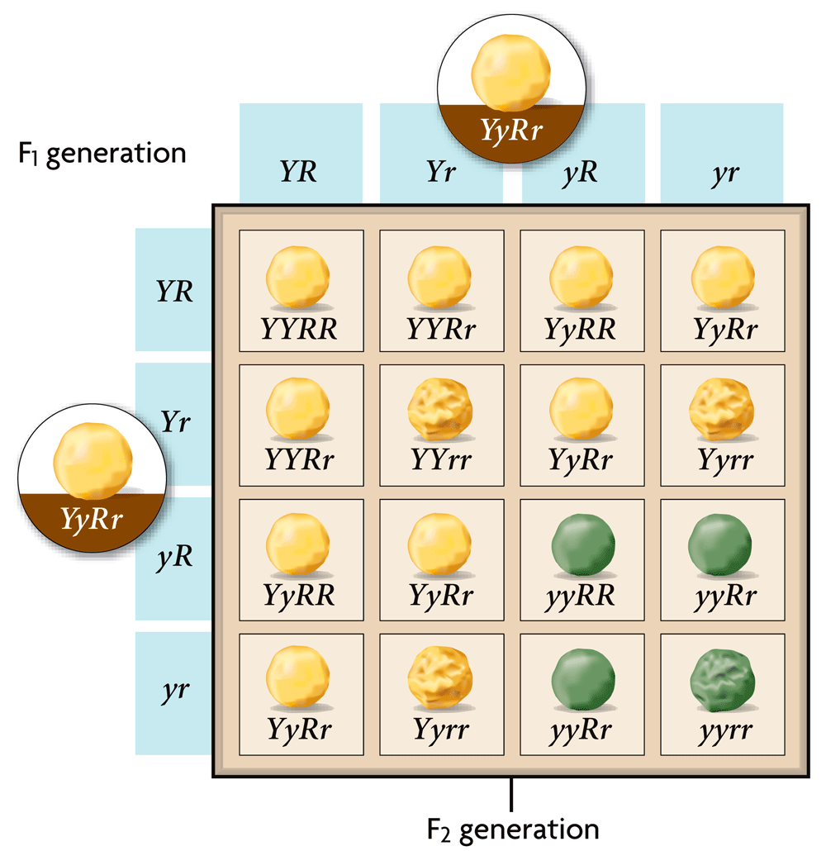
A dihybrid cross involves two traits.
Mendel’s dihybrid crosses with heterozygous plants yielded a 9:3:3:1 phenotypic ratio.
Mendel’s dihybrid crosses led to his second law, the law of independent assortment.
The law of independent assortment states that allele pairs separate independently of each other during meiosis.

Slide 95
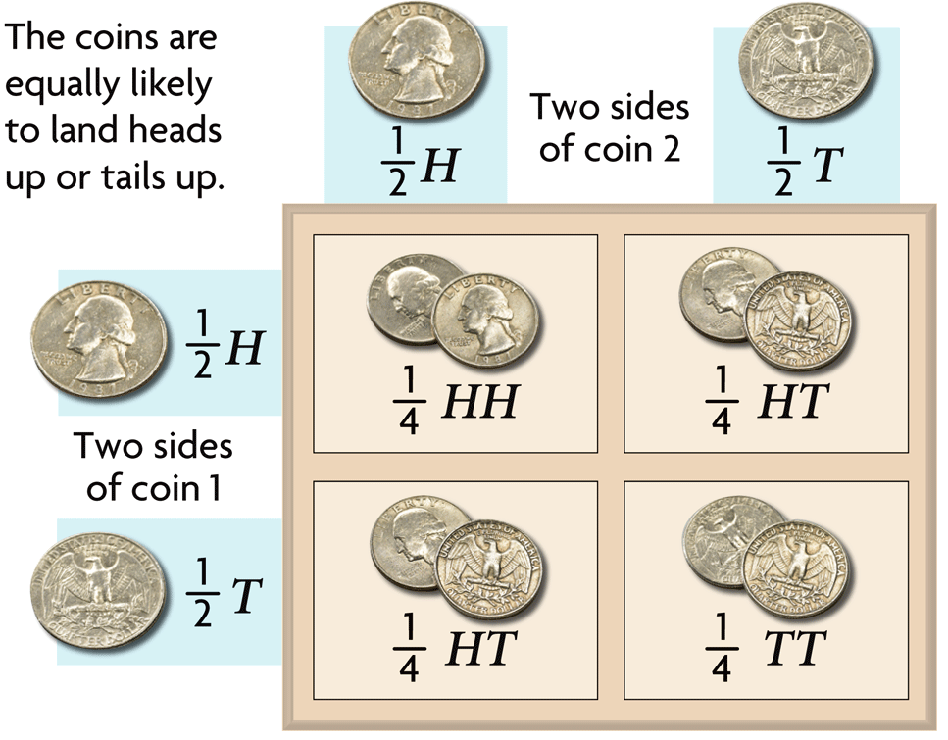
Heredity patterns can be calculated with probability.
Probability is the likelihood that something will happen.
Probability predicts an average number of occurrences, not an exact number of occurrences.
Probability =
number of ways a specific event can occur
number of total possible outcomes
Probability applies to random events such as meiosis and fertilization.

Slide 96
6.6 Notes

Slide 97
KEY CONCEPT Independent assortment and crossing over during meiosis result in genetic diversity.

Slide 98
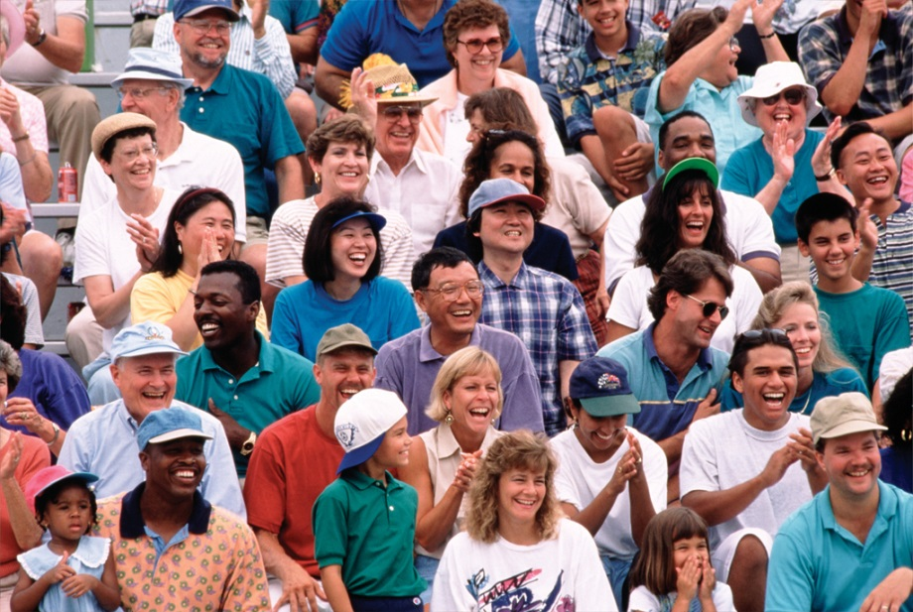
Sexual reproduction creates unique combinations of genes.
Sexual reproduction creates unique combination of genes.
independent assortment of chromosomes in meiosis
random fertilization of gametes
Unique phenotypes may give a reproductive advantage to some organisms.

Slide 99
Crossing over during meiosis increases genetic diversity.
Crossing over is the exchange of chromosome segments between homologous chromosomes.
occurs during prophase I of meiosis I
results in new combinations of genes

Slide 100
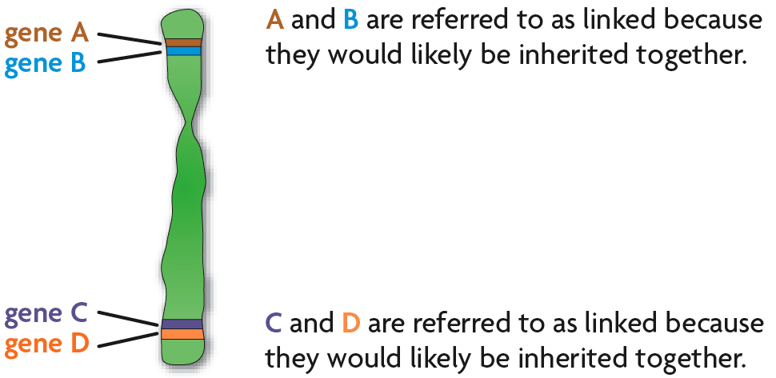
Chromosomes contain many genes.
The farther apart two genes are located on a chromosome, the more likely they are to be separated by crossing over.
Genes located close together on a chromosome tend to be inherited together, which is called genetic linkage.
Genetic linkage allows the distance between two genes to be calculated.

Slide 101
Genetics Project – Offspring Creation

Slide 102
Chromosomes contain many genes.
The farther apart two genes are located on a chromosome, the more likely they are to be separated by crossing over.
Genes located close together on a chromosome tend to be inherited together, which is called genetic linkage.
Genetic linkage allows the distance between two genes to be calculated.

Slide 103
Mini Quiz
Complete the following crosses using simple Punnett Squares
BB x Bb
Yy x yy
Hh x Hh
Find the percentage of dominant phenotypes for each of the crosses
Find the percentage of recessive phenotypes for each of the crosses
Now, use the following table to help identify the phenotypes of the offspring.
 | Flower color | Fruit Color | Plant Height
DOMINANT | Blue (B) | Yellow (Y) | Tall (H)
RECESSIVE | White (b) | Green (y) | Short (h)

Slide 104
Warm up (3-15-16)
Describe how sex-linked genes are expressed differently in males and females.

Slide 105
Outline
Objectives
Read ch. 7.1
Notes ch. 7.1
Sex linked inheritance p. 202

Slide 106
Objectives
Describe how sexual reproduction creates unique gene combinations
Explain how crossing over during meiosis increases genetic diversity

Slide 107
Extending Mendelian Genetics

Slide 108
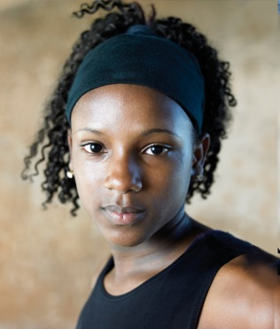
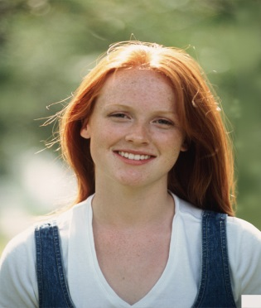
7.1 KEY CONCEPT The chromosomes on which genes are located can affect the expression of traits.

Slide 109
Two copies of each autosomal gene affect phenotype.
Mendel studied autosomal gene traits, like hair texture.

Slide 110
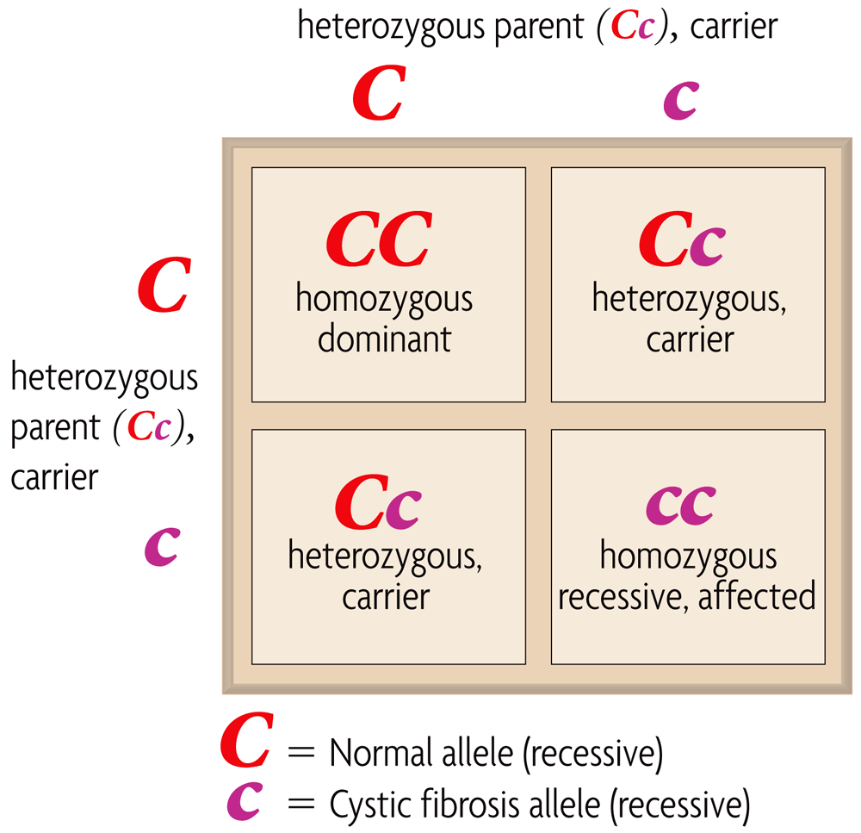
Mendel’s rules of inheritance apply to autosomal genetic disorders.
A heterozygote for a recessive disorder is a carrier.
Disorders caused by dominant alleles are uncommon.
(dominant)

Slide 111
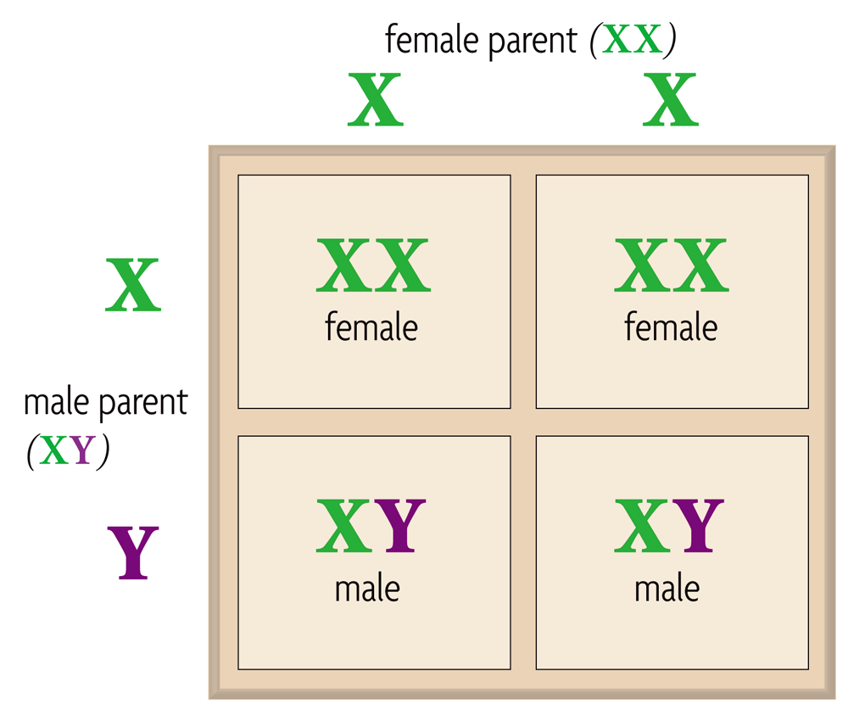
Males and females can differ in sex-linked traits.
Genes on sex chromosomes are called sex-linked genes.
Y chromosome genes in mammals are responsible for male characteristics.
X chromosome genes in mammals affect many traits.

Slide 112
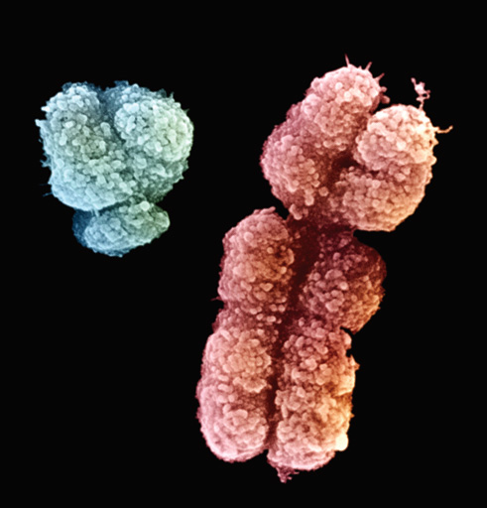
Male mammals have an XY genotype.
All of a male’s sex-linked genes are expressed.
Males have no second copies of sex-linked genes.

Slide 113
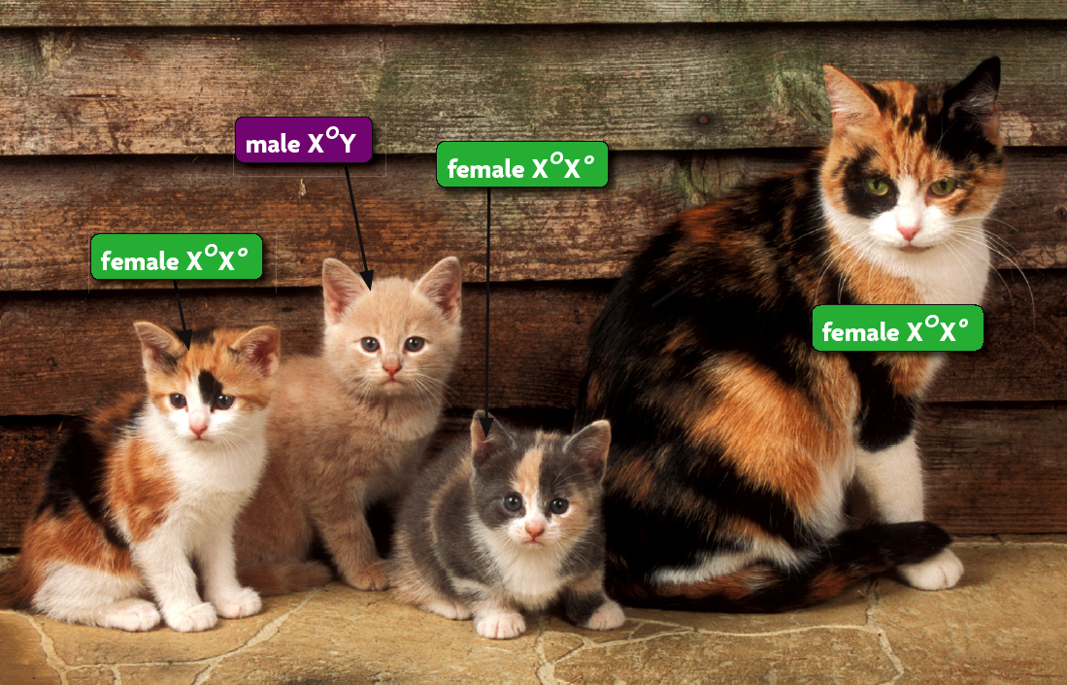
Female mammals have an XX genotype.
Expression of sex-linked genes is similar to autosomal genes in females.
X chromosome inactivation randomly “turns off” one X chromosome.

Slide 114
Sex – Linked Inheritance
P. 202
Problem – How does probability explain sex-linked inheritance
Answer this question as your prediction
Procedure – follow the procedure on page 202
When you finish the procedure, answer the analysis and conclusion questions in your composition notebook using complete sentences.

Slide 115
Warm up (3-16-16)
Explain what happens during fertilization. (Include the terms – gametes, diploid and haploid in your answer)

Slide 116
Outline
Objectives
Sex linked inheritance p. 202

Slide 117
Objectives
Describe how sexual reproduction creates unique gene combinations
Explain how crossing over during meiosis increases genetic diversity

Slide 118
Sex – Linked Inheritance
P. 202
Problem – How does probability explain sex-linked inheritance
Answer this question as your prediction
Procedure – follow the procedure on page 202
When you finish the procedure, answer the analysis and conclusion questions in your composition notebook using complete sentences.

Slide 119
7.2 KEY CONCEPT Phenotype is affected by many different factors.

Slide 120
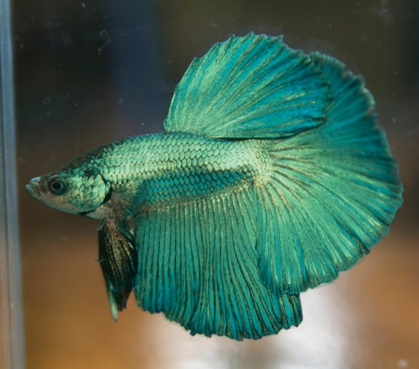
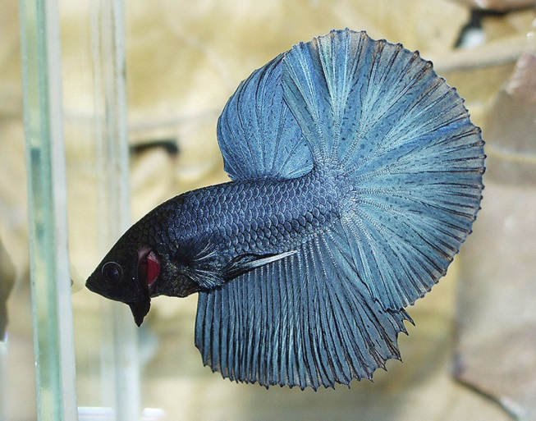
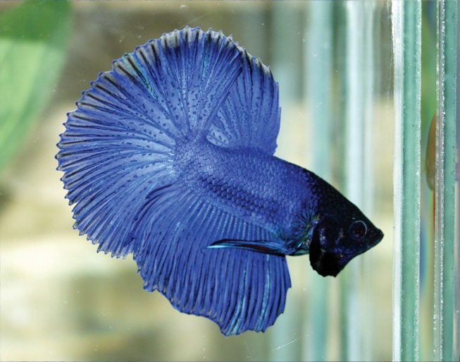
Phenotype can depend on interactions of alleles.
In incomplete dominance, neither allele is completely dominant nor completely recessive.
Heterozygous phenotype is intermediate between the two homozygous phenotypes
Homozygous parental phenotypes not seen in F₁ offspring

Slide 121
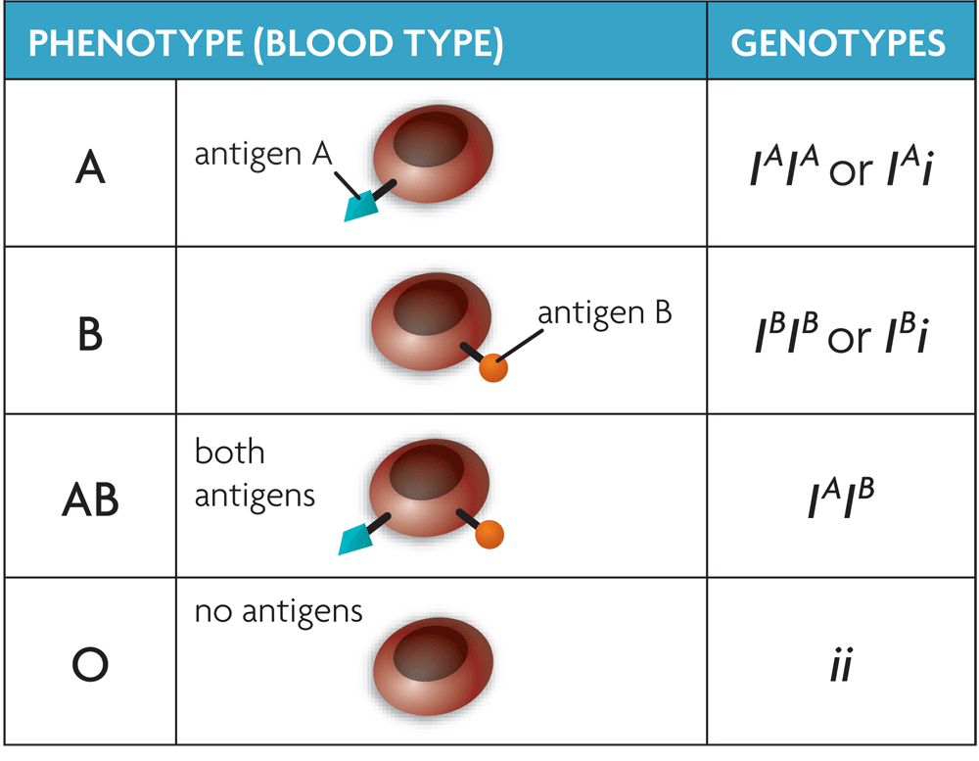
Codominant alleles will both be completely expressed.
Codominant alleles are neither dominant nor recessive.
The ABO blood types result from codominant alleles.
Many genes have more than two alleles.

Slide 122
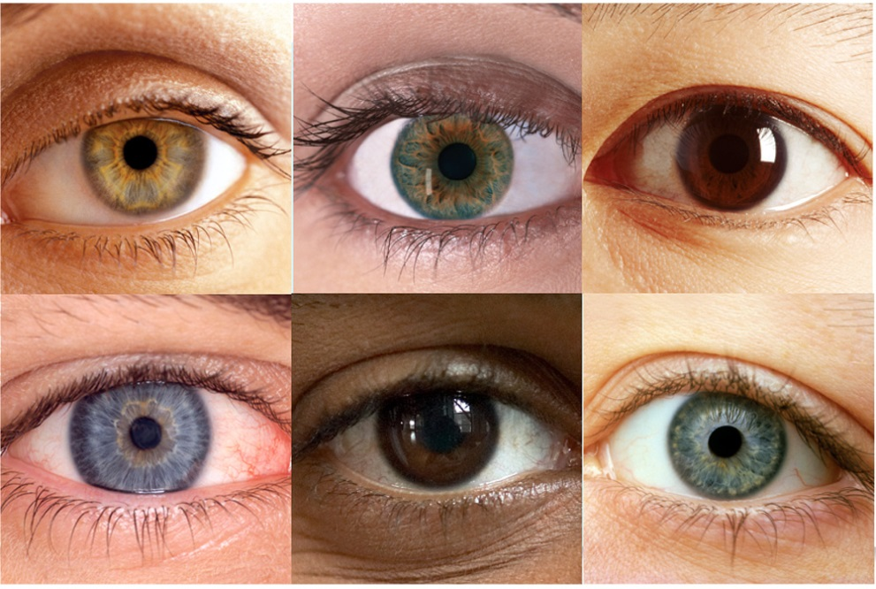
Many genes may interact to produce one trait.
Polygenic traits are produced by two or more genes.
Order of dominance: brown > green > blue.

Slide 123
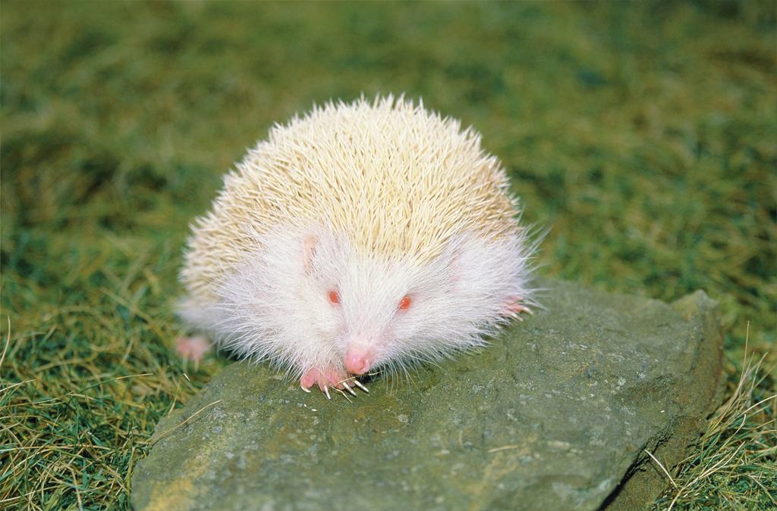
An epistatic gene can interfere with other genes.

Slide 124
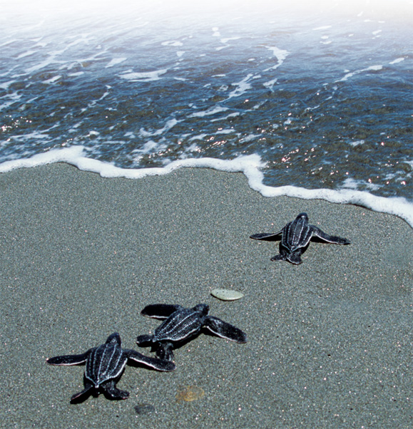
The environment interacts with genotype.
Phenotype is a combination of genotype and environment.
The sex of sea turtles depends on both genes and the environment
Height is an example of a phenotype strongly affected by the environment.

Slide 125
Warm up (3-17-16)
Explain what codominance is and give an example of a codominant trait.

Slide 126
Outline
Objectives
Codominance p.208
Read 7.3
Notes 7.3

Slide 127
Objectives
Explore codominance by investigating the inheritance of sickle cell disease within a family
Infer genotypes using knowledge of heterozygous and homozygous alleles
Use punnett squares to predict patterns of gene inheritance and gene expression

Slide 128
p. 208 Codominance
Read through the background information about sickle cell disease. Then follow the procedure to answer the 5 questions in your composition notebook. Please use complete sentences while working on this.

Slide 129
7.3 KEY CONCEPT Genes can be mapped to specific locations on chromosomes.

Slide 130
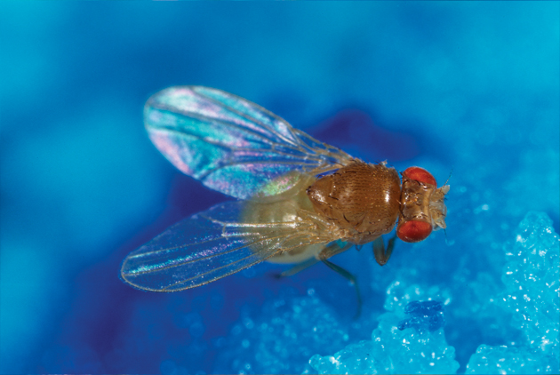
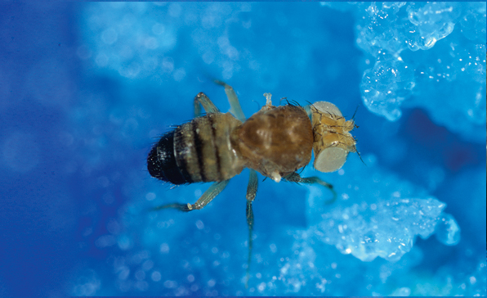
Gene linkage was explained through fruit flies.
Morgan found that linked traits are on the same chromosome.
Chromosomes, not genes, assort independently during meiosis.
Wild type
Mutant

Slide 131
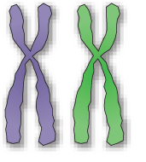
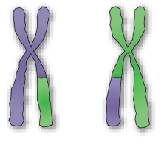
Linked genes are not inherited together every time.
Chromosomes exchange homologous genes during meiosis.

Slide 132
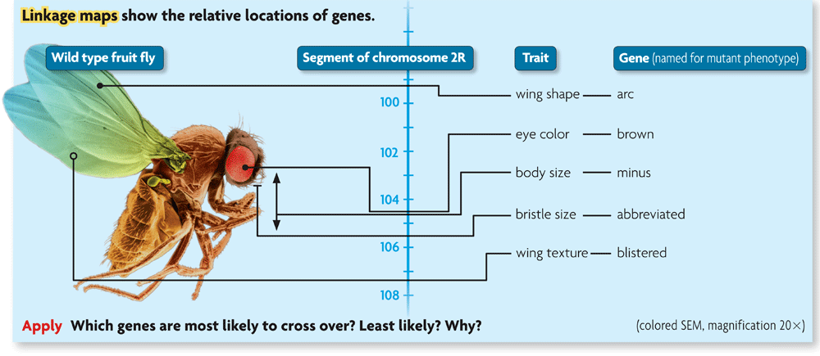
Linkage maps estimate distances between genes.
The closer together two genes are, the more likely they will be inherited together.
Cross-over frequencies are related to distances between genes.
Linkage maps show the relative locations of genes.

Slide 133
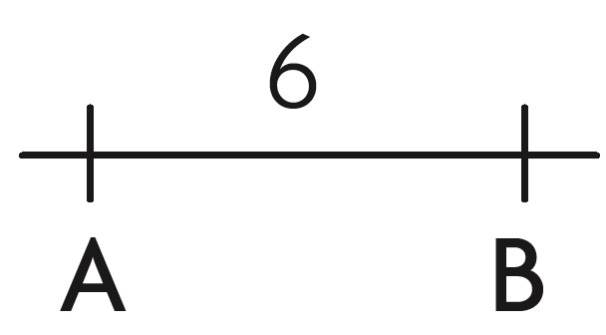
Cross-over frequencies can be converted into map units.
gene A and gene B cross over 6.0 percent of the time
gene B and gene C cross over 12.5 percent of the time
gene A and gene C cross over 18.5 percent of the time

Slide 134
Warm up (3-21-16)

Slide 135
Outline
Objectives

Slide 136
Objectives

Slide 137
7.4 KEY CONCEPT A combination of methods is used to study human genetics.

Slide 138
Human genetics follows the patterns seen in other organisms.
The basic principles of genetics are the same in all sexually reproducing organisms.
Inheritance of many human traits is complex.
Single-gene traits are important in understanding human genetics.

Slide 139
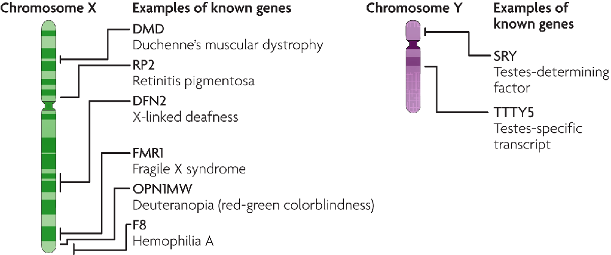
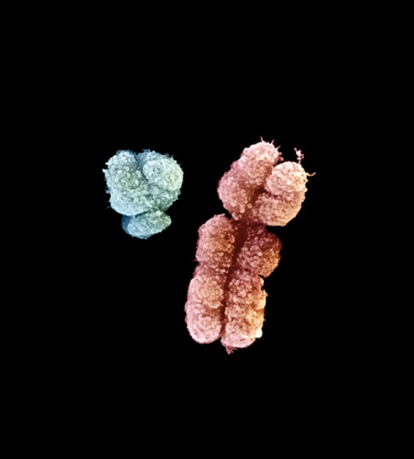
Females can carry sex-linked genetic disorders.
Males (XY) express all of their sex linked genes.
Expression of the disorder depends on which parent carries the allele and the sex of the child.
Y
X

Slide 140
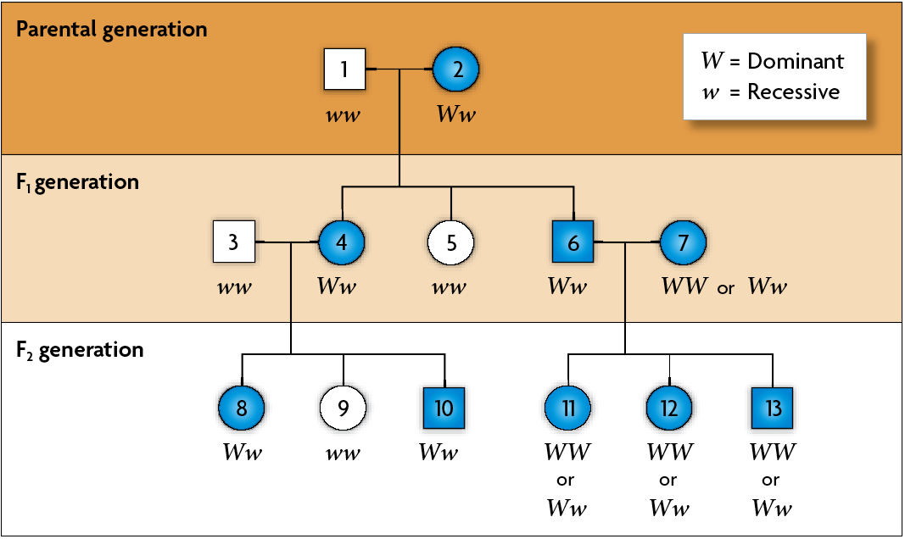
A pedigree is a chart for tracing genes in a family.
Phenotypes are used to infer genotypes on a pedigree.
Autosomal genes show different patterns on a pedigree than sex-linked genes.

Slide 141
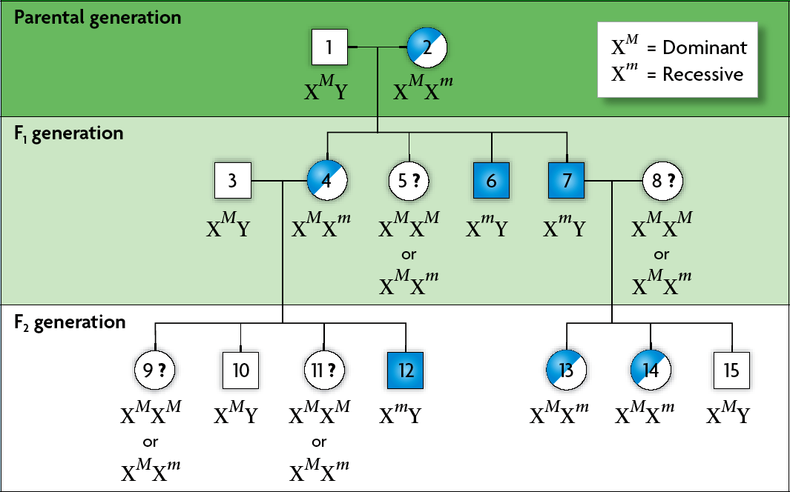
If the phenotype is more common in males, the gene is likely sex-linked.

Slide 142
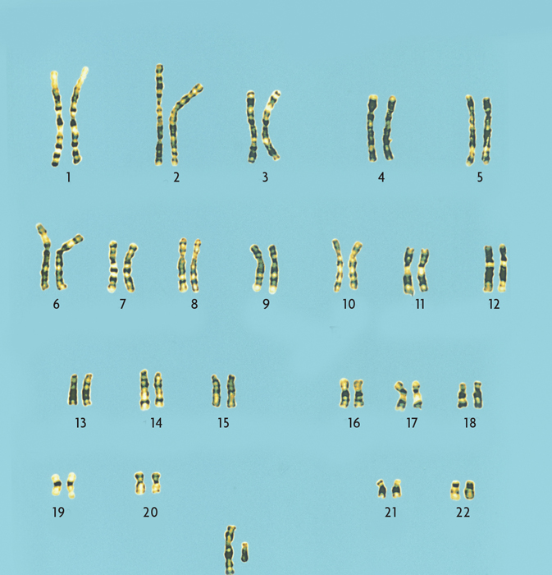
Several methods help map human chromosomes.
A karyotype is a picture of all chromosomes in a cell.
X Y

Slide 143
Karyotypes can show changes in chromosomes.
deletion of part of a chromosome or loss of a chromosome
large changes in chromosomes
extra chromosomes or duplication of part of a chromosome

Slide 144
Blood Smears

Slide 145
Warm up (3-27-15)
Explain how particular traits can be polygenic traits. Provide an example of polygenic traits.

Slide 146
Outline
Objectives
Chapter 7 quizzes
Take home test for homework

Slide 147
Objectives
Students will be able to identify the difference between sex cells and somatic cells and explain why these two types of cells are different.
Students will be able to identify the steps in meiosis and explain what is occurring to the chromosomes at each step

Slide 148
Blood Typing

Slide 149
Chapter 6-7 Quiz

Slide 150
Blood Typing
http://www.redcrossblood.org/learn-about-blood/blood-types

