Slide 1
Metric System

Slide 2
Happy Monday!
Warm-up sheet explanation and set-up
Warm-up
Pass out Metric System Unit Objectives

Slide 3
Warm Up (8-24-15)
Please get out your warm up sheet and answer the following questions.
Write down 3 things you know about the metric system.
Write down 2 things that you don’t understand about the metric system.

Slide 4
Outline
Objectives
Why do I care?
Review
Metric System Monday

Slide 5
Objectives
learn how to convert quantities from the English system to the metric system
think about the many ways in which measuring quantities is a part of daily life.
Briefly review the metric system
Determine how to correctly measure and report length of items using the metric system

Slide 6
Why do I care?
Most of the world uses the metric system
Science uses the metric system
It is easier!

Slide 7
Metric System Review
https://www.youtube.com/watch?v=KfrCaKyhwZk

Slide 8
Metric System Class Sheet
Work on answering the questions as an individual
Try to come up with an answer for every question
You may estimate if you are not sure of the exact numbers

Slide 9
How tall are you?
How tall is your house? (We say “stories” try to think in terms of feet)
What is the difference in height between you and your best friend?
What is the typical weight of a baby when they are born?
How much milk do your parents typically buy at one time?
How much soda/water do you typically drink in a day?

Slide 10
What is the distance in miles from your home to school?
What's the typical speed limit (in miles per hour) around town?
What's the typical speed limit (in miles per hour) on the highway?
Estimate how much your backpack weighs on a typical afternoon.
How far is one lap around the football field on the track?

Slide 11
Warm Up (8-25-15)
Explain how changing the standard system in America would impact the citizens living there. (We use English system, what would happen if we switched to the metric system?)

Slide 12
Outline
Objectives
Discussion Questions
Metric System Debate
Metric System Exploration

Slide 13
Objectives
learn how to convert quantities from the English system to the metric system
think about the many ways in which measuring quantities is a part of daily life.
Briefly review the metric system
Determine how to correctly measure and report length of items using the metric system

Slide 14
Discussion Questions
Why do you think it would be so hard for the United States to switch to the metric system? Do you think it is in the country's best interest to overcome these difficulties? Why or why not?
Which system did you find easier to use? Why?

Slide 15
DEBATE
Claim, Evidence, Reasoning
Claim: debatable statement that can be argued
Evidence: Gather some research and information to support your claim
Reasoning: Explain your evidence and how it supports your claim
Justification: Some might say _____ but that is wrong because _______

Slide 16
Discussion Questions
Do you think it is confusing that the United States uses a different measuring system from the rest of the world? What kinds of problems arise because of the use of a different measuring system?
Were you surprised at how many measurements you use in daily life? Why or why not?

Slide 17
Discussion Questions
Think about specific jobs that require frequent measuring, such as architecture and construction. What changes would people in these professions have to make in their daily lives if the United States switched to the metric system? Consider how the change to metric would affect all aspects of their jobs, from buying materials to measuring spaces to actually constructing buildings.

Slide 18
Discussion Questions
Suppose you wanted to bake a cake, and the recipe you wanted to use listed metric quantities but your measuring cups and spoons were based on English measurements. How would you convert each quantity? What tools could help you solve this problem?

Slide 19
Metric System Exploration Lab
You will be working on this lab as an INDIVIDUAL.
  What does this look like?
There are some stations in the lab room…
  What does this look like?
What’s the point?
Expectations

Slide 20
Metric System Lab Expectations
Work to solve the problems
  Yes, they may be difficult, but that is the point.
  No, I am not trying to make you suffer.
  Diligently attempt and accomplish the tasks
Listen carefully to directions
  Be aware of others / teacher
Try your best
  The harder you try, the better you will do on tests and future assignments
Ask questions
  If you ask now, you will have a better understanding to complete things on your own in the future.

Slide 21
Warm Up (8-26-15)
Suppose you wanted to bake a cake, and the recipe you wanted to use listed metric quantities but your measuring cups and spoons were based on English measurements. How would you convert each quantity? What tools could help you solve this problem?

Slide 22
Outline
Objectives
Finish Debate / Discussion Questions
Metric Exploration
Discuss Mass and Temperature

Slide 23
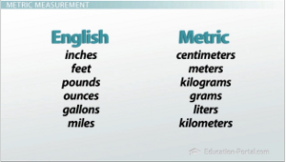

Slide 24
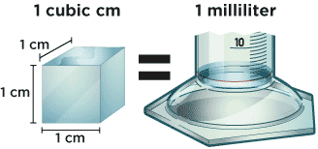

Slide 25
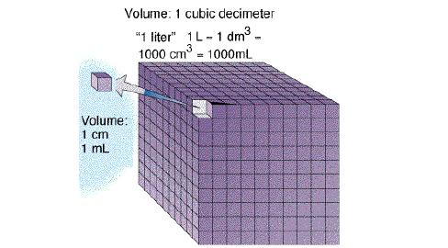

Slide 26
Metric System Exploration Lab
You will be working on this lab as an INDIVIDUAL.
  What does this look like?
There are some stations in the lab room…
  What does this look like?
What’s the point?
Expectations

Slide 27
Metric System Lab Expectations
Work to solve the problems
  Yes, they may be difficult, but that is the point.
  No, I am not trying to make you suffer.
  Diligently attempt and accomplish the tasks
Listen carefully to directions
  Be aware of others / teacher
Try your best
  The harder you try, the better you will do on tests and future assignments
Ask questions
  If you ask now, you will have a better understanding to complete things on your own in the future.

Slide 28
Warm Up (8-27-15)
Without looking at your cheat sheet, write down the Metric units that correspond to these English units
Inches = ?
Feet = ?
Pounds = ?
Ounces = ?
Gallons = ?
Miles = ?

Slide 29
Outline
Objectives
Metric exploration
Mass / Temperature

Slide 30
Objectives
learn how to convert quantities from the English system to the metric system
think about the many ways in which measuring quantities is a part of daily life.
Briefly review the metric system
Determine how to correctly measure and report length of items using the metric system

Slide 32
Practice
http://www.sciencegeek.net/Chemistry/taters/Unit0Metrics.htm

Slide 33

Lesson 1: Length
T. Trimpe 2008 http://sciencespot.net/

Slide 34
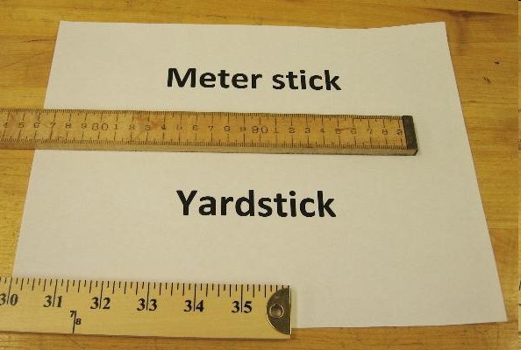
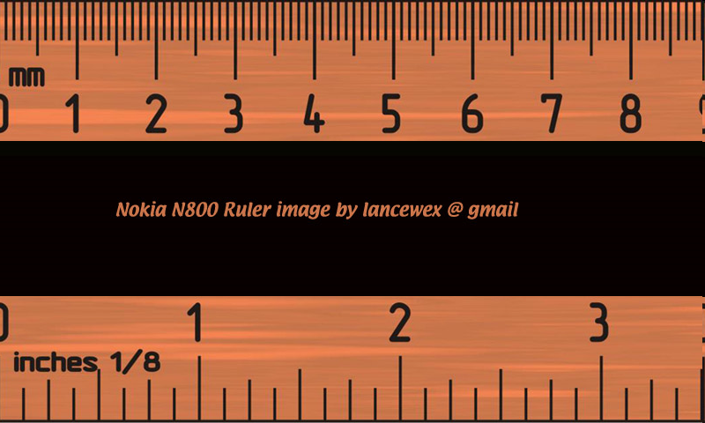
English vs. Metric Units
Which is longer?
A. 1 mile or 1 kilometer
B. 1 yard or 1 meter
C. 1 inch or 1 centimeter
1 mile
1.6 kilometers
1 inch = 2.54 centimeters
1 yard = 0.9444 meters
Left Image: http://webapps.lsa.umich.edu/physics/demolab/controls/imagedemosm.aspx?picid=1167
Right Image: http://share.lancealan.com/N800%20ruler.jpg

Slide 35
km
Metric Units
m
cm
mm
The basic unit of length in the metric system is the meter and is represented by a lowercase m.
Standard: The distance traveled by light in absolute vacuum in 1⁄299,792,458 of a second.
Metric Units
1 Kilometer (km) = 1000 meters
1 Meter = 100 Centimeters (cm)
1 Meter = 1000 Millimeters (mm)
Click the image to watch a short video about the meter.
Which is larger?
A. 1 meter or 105 centimeters
B. 4 kilometers or 4400 meters
C. 12 centimeters or 102 millimeters
D. 1200 millimeters or 1 meter

Slide 36
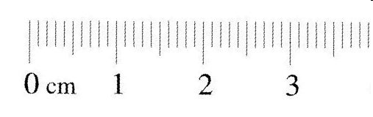
Measuring Length
How many millimeters are in 1 centimeter?
1 centimeter = 10 millimeters
What is the length of the line in centimeters? _______cm
What is the length of the line in millimeters? _______mm
What is the length of the line to the nearest centimeter? ________cm
HINT: Round to the nearest centimeter – no decimals.
Ruler: http://www.k12math.com/math-concepts/measurement/ruler-cm.jpg

Slide 37
Length Lab

Slide 38
Lesson 2:
Mass
T. Trimpe 2008 http://sciencespot.net/

Slide 39
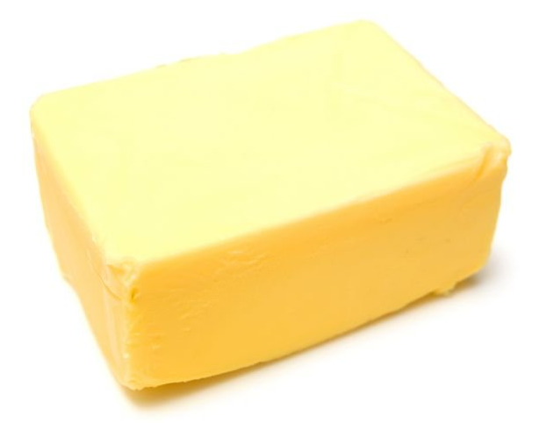
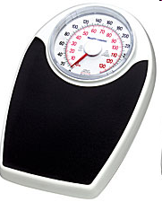
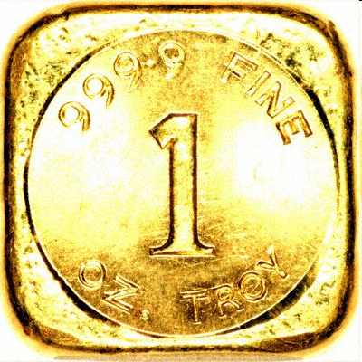
English vs. Metric Units
Which is larger?
1. 1 Pound or 100 Grams
2. 1 Kilogram or 1 Pound
3. 1 Ounce or 1000 Milligrams
1 pound = 453.6 grams
1 ounce of gold = 28,349.5 milligrams
100 kilogram =
220 pounds

Slide 40

kg
Metric Units
g
cg
mg
Mass refers to the amount of matter in an object.
The base unit of mass in the metric system in the gram and is represented by g.
Standard: 1 kilogram is equal to the mass of the International Prototype Kilogram (IPK), a platinum-iridium cylinder kept by the BIPM at Sèvres, France.
Kilogram Prototype
Metric Units
1 Kilogram (kg) = 1000 Grams (g)
1 Gram (g) = 1000 Milligrams (mg)
Which is larger?
A. 1 kilogram or 1500 grams
B. 1200 milligrams or 1 gram
C. 12 milligrams or 12 kilograms
D. 4 kilograms or 4500 grams
Kilogram Prototype Image - http://en.wikipedia.org/wiki/Kilogram

Slide 41
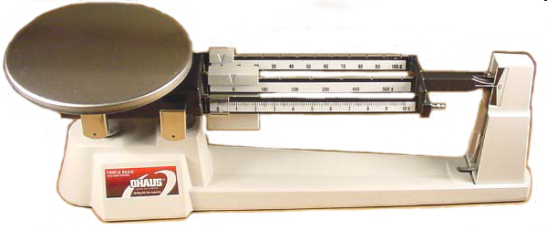
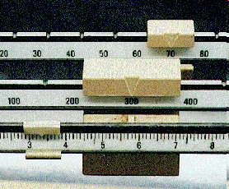
Measuring Mass
We will be using triple-beam balances to find the mass of various objects.
The objects are placed on the scale and then you move the weights on the beams until you get the lines on the right-side of the scale to match up.
Once you have balanced the scale, you add up the amounts on each beam to find the total mass.
What would be the mass of the object measured in the picture?
_______ + ______ + _______ = ________ g
Top Image: http://www.southwestscales.com/Ohaus_Triple_Beam_750-SO.jpg
Bottom Image: http://www.regentsprep.org/Regents/biology/units/laboratory/graphics/triplebeambalance.jpg

Slide 42
Measuring Mass – Triple-Beam Balance
1st – Place the item on the scale.
2nd – Slide the large weight to the right until the arm drops below the line. Move the rider back one groove. Make sure it “locks” into place.
3rd – Repeat this process with the top weight. When the arm moves below the line, back it up one groove.
4th – Slide the small weight on the front beam until the lines match up.
5th – Add the amounts on each beam to find the total mass to the nearest tenth of a gram.
Click here to try an online activity.

Slide 43
Digital Scales
How do I use a digital scale?
What is the difference between the CS200 scale and the CS2000 scale?

Slide 44
How to Use a Digital Scale
What are you measuring? (some substances might need a paper bowl)
Zero out the scale with the bowl so you don’t have to subtract that out later.
Mass the item
Record the mass as accurately as needed.

Slide 45
Example
Problem: What is the temperature in °C of a 256 K object?
Solution: The conversion formula for °C to K is
TC = (TK) - 273
TC = 256 - 273
TC = -17 °C
Answer: The temperature in Celsius of a 256 K object is -17 °C.

Slide 46
Mass / Temperature Lab
Work with a different partner than you did during the length lab.
Make sure that both of you are working together!
Use your inside voices please

Slide 47
Warm Up (8-28-15)
Please get out your warm-up sheet and answer the following questions
What is the metric unit of length?
How many mm are in a cm?
How many cm are in a m?

Slide 48
Outline
Objectives
Review Conversions
Volume Notes
Metric Exploration – Homework!!
What’s on the Test?

Slide 49
Objectives
Determine how to correctly measure and report volume of items using the metric system
Learn how to convert quantities from the English system to the Metric system

Slide 50
Review Conversions!

Slide 51
Metric System Exploration Lab
You will be working on this lab as an INDIVIDUAL.
  What does this look like?
There are some stations in the lab room…
  What does this look like?
What’s the point?
Expectations

Slide 52
Metric System Lab Expectations
Work to solve the problems
  Yes, they may be difficult, but that is the point.
  No, I am not trying to make you suffer.
  Diligently attempt and accomplish the tasks
Listen carefully to directions
  Be aware of others / teacher
Try your best
  The harder you try, the better you will do on tests and future assignments
Ask questions
  If you ask now, you will have a better understanding to complete things on your own in the future.

Slide 53
Temperature Lab
On the back of your mass sheet… Add the following questions
Measure the temperature of the three beakers of water. Use Celsius for your first measurements of the beakers and then do the math to convert to Fahrenheit and Kelvin.

Slide 54
Temperature
Celsius is the most commonly used unit of temperature
In the U.S. we use Fahrenheit
The SI unit of temperature is Kelvin
From To Fahrenheit To Celsius To Kelvin
Fahrenheit (F) F (F - 32) * 5/9 (F - 32) * 5/9 + 273.15
Celsius (C or º) (C * 9/5) + 32 C C + 273.15
Kelvin (K) (K - 273.15) * 9/5 + 32 K - 273.15 K

Slide 55
Warm Up (8-31-15)
What is the Metric unit of volume?
800mm = ______ m?
How many cm is 548 mm?

Slide 56
Outline
Objectives
Metric Explorations – What isn’t done today is Homework!
Surface Area
Conversions

Slide 57
Objectives
Learn how to convert quantities from the English system to the Metric system
Work to convert quantities within the Metric system
To review surface area
To convert English units to Metric units and use those conversions to solve equations.

Slide 58
Metric System Exploration Lab
You will be working on this lab as an INDIVIDUAL.
  What does this look like?
There are some stations in the lab room…
  What does this look like?
What’s the point?
Expectations

Slide 59
Metric System Lab Expectations
Work to solve the problems
  Yes, they may be difficult, but that is the point.
  No, I am not trying to make you suffer.
  Diligently attempt and accomplish the tasks
Listen carefully to directions
  Be aware of others / teacher
Try your best
  The harder you try, the better you will do on tests and future assignments
Ask questions
  If you ask now, you will have a better understanding to complete things on your own in the future.

Slide 60
Metric Exploration
Whatever you don’t finish today is homework… so, be sure that you get the initial question for each of the problems done. (Example: 1a. 2a. 3a. 7a. 8a. 9a.) You can work on the conversions at home.

Slide 61
Lesson 3:
Volume
T. Trimpe 2008 http://sciencespot.net/

Slide 62

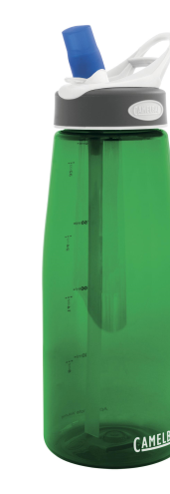
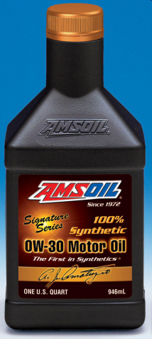
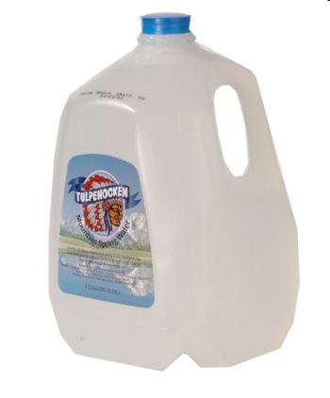
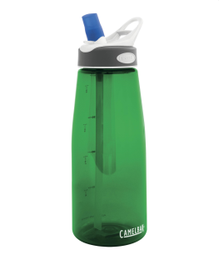
English vs. Metric Units
Which is larger?
A. 1 liter or 1 gallon
B. 1 liter or 1 quart
C. 1 milliliter or 1 fluid ounce
1 fl oz = 29.573 ml
1 12-oz can of soda would equal approximately 355 ml.
1 quart = 0.946 liters
1 gallon = 3.79 liters
It would take approximately 3 ¾ 1-liter bottles to equal a gallon.

Slide 63
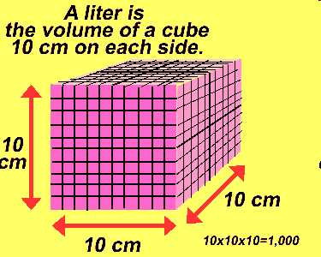
kL
Metric Units
L
cL
mL
Volume is the amount of space an object takes up.
The base unit of volume in the metric system in the liter and is represented by L or l.
Standard: 1 liter is equal to one cubic decimeter
Metric Units
1 liter (L) = 1000 milliliters (mL)
1 milliliter (mL) = 1 cm³ (or cc) = 1 gram*
Which is larger?
Click the image to watch a short video about volume.
A. 1 liter or 1500 milliliters
B. 200 milliliters or 1.2 liters
C. 12 cm³ or 1.2 milliliters*
* When referring to water
Liter Image: http://www.dmturner.org/Teacher/Pictures/liter.gif

Slide 64
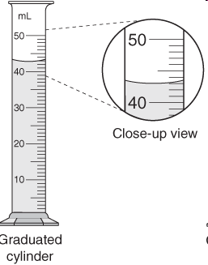
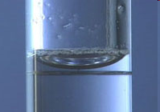
Measuring Volume
We will be using graduated cylinders to find the volume of liquids and other objects.
Read the measurement based on the bottom of the meniscus or curve. When using a real cylinder, make sure you are eye-level with the level of the water.
What is the volume of water in the cylinder? _____mL
What causes the meniscus?
A concave meniscus occurs when the molecules of the liquid attract those of the container. The glass attracts the water on the sides.
Top Image: http://www.tea.state.tx.us/student.assessment/resources/online/2006/grade8/science/images/20graphicaa.gif
Bottom Image: http://morrisonlabs.com/meniscus.htm

Slide 65
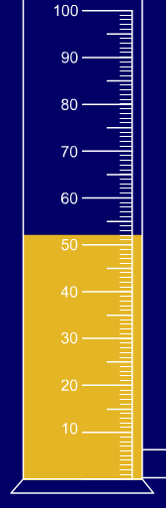
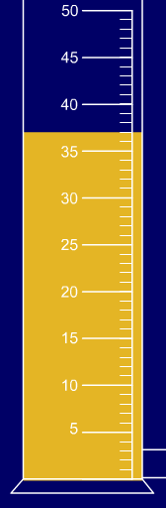
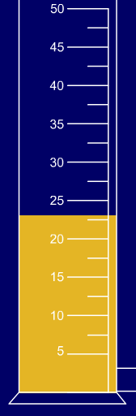
Measuring Liquid Volume
What is the volume of water in each cylinder?
Images created at http://www.standards.dfes.gov.uk/primaryframework/downloads/SWF/measuring_cylinder.swf
A
B
C
Pay attention to the scales for each cylinder.

Slide 66
Measuring Solid Volume
We can measure the volume of regular object using the formula length x width x height.
9 cm
_____ X _____ X _____ = _____
8 cm
10 cm
We can measure the volume of
irregular object using water displacement.
Amount of H₂O with object = ______
About of H₂O without object = ______
Difference = Volume = ______
http://resources.edb.gov.hk/~s1sci/R_S1Science/sp/en/syllabus/unit14/new/testingmain1.htm
Click here for an online activity about volume.
Choose Lessons → Volume & Displacement

Slide 67
https://www.youtube.com/watch?v=JijhDDJvExo

Slide 68
Volume Lab

Slide 69
Surface Area
What are we measuring? What are we trying to find?

Slide 70
Review
What have we discussed about the metric system?
STRIKES AND WISHES
In your science notebooks, draw a line under what you have been working on for a particular page.
What struck you about the metric system (something that will stick with you) and what do you wish we had covered more of?

Slide 71
English ←→ Metric Conversions
T. Trimpe 2008 http://sciencespot.net/

Slide 72
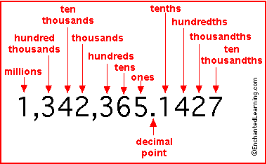
Place Value Review

Slide 73
1 inch = 2.54 cm
1 ounce = 28.35 g
1 kg = 2.205 lbs

Slide 74
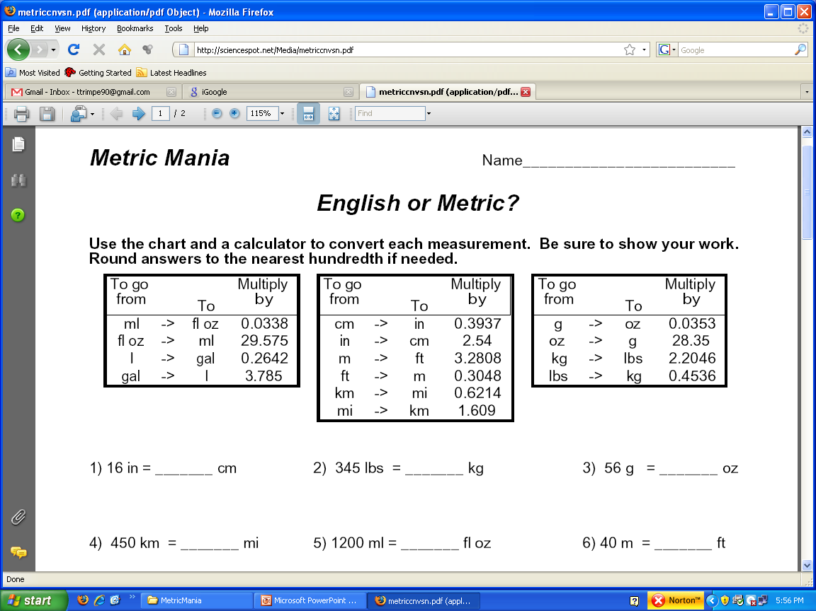

Slide 75
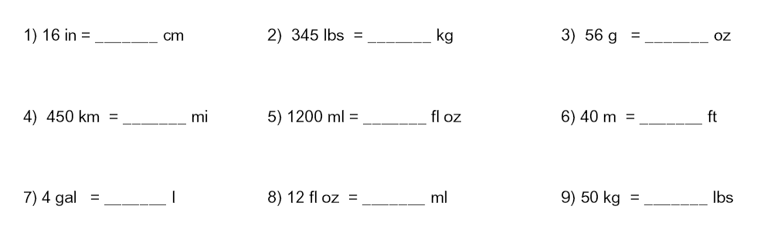
English & Metric Conversions

Slide 76
Warm Up (9-1-15)
What is the metric unit of mass?
Are weight and mass the same thing? If no, tell me what the difference is.

Slide 77
Outline
Objectives
Discuss Metric Exploration 5 & 6
Conversions review
Conversions Quiz
Metric System Exploration Discussion

Slide 78
Objectives
Learn how to convert quantities form the English system to the Metric system
Learn how to convert quantities within the Metric system
Students will demonstrate knowledge of conversions by taking the metric system conversion quiz

Slide 79
Metric System Exploration Lab
Working on 5 & 6 today…
You will need to get questions 5 and 6 done today.
As a table group you will be completing these.
Use a digital scale for these questions. Use the massing cups to hold the ice cube.
You will need to work quickly as to not melt the ice cubes
Make sure you record the initial volume of the graduated cylinder

Slide 80
Metric System Lab Expectations
Work to solve the problems
  Yes, they may be difficult, but that is the point.
  No, I am not trying to make you suffer.
  Diligently attempt and accomplish the tasks
Listen carefully to directions
  Be aware of others / teacher
Try your best
  The harder you try, the better you will do on tests and future assignments
Ask questions
  If you ask now, you will have a better understanding to complete things on your own in the future.

Slide 81
Conversions Practice
Any conversions you would like to review?
Any specific conversions that are confusing to you?

Slide 82
Kayla bought two pumpkins. The larger pumpkin was three kilograms. The smaller pumpkin was only a third the weight of the larger pumpkin. What is the weight of the smaller pumpkin in grams?

Slide 83
1 kg
1000 g

Slide 84
There are eight aluminum cans sitting on the shelf. Each can contains two hundred sixty-four ml of soup. Melissa poured all the soup into one bowl. How many liters of soup did she have?

Slide 85
2.112 L

Slide 86
Anthony has a pet spider and a pet guinea pig. The spider is 10 mm long and the guinea pig is 35 cm long. How much longer is the guinea pig than the spider (in mm)?

Slide 87
340 mm

Slide 88
Convert 687 K into both Celsius and Fahrenheit.

Slide 89
413.85 C
776.93 F

Slide 90
Convert 98,765ft into cm. What is that distance in km?

Slide 91
3010357.2 cm
30.1036 km

Slide 92
More Practice
http://www.regentsprep.org/regents/math/algebra/am2/pracmet.htm

Slide 93
Conversions Quiz
No talking
You may use the reference materials that I provided you with in your composition notebook
When you finish, turn it over and sit quietly
If you have a question please raise your hand

Slide 95
Warm Up (9-2-15)
***Please do not touch the materials in the center of your tables. Get out your warm ups and get started*****
How many centimeters are in an inch?
58cm = _______in?
Do you think the US should switch to the metric system? How would you suggest presenting this topic to important officials?

Slide 96
Outline
Objectives
Metric System Quick Labs

Slide 97
Objectives
To correctly use the ladder method to complete metric conversions.
To demonstrate knowledge of the metric system by completing the metric system lab.

Slide 98
Metric System Quick Labs : Temperature
UNIT | Beaker 1 | Beaker2 | Beaker3
Celsius
Fahrenheit
Kelvin

Slide 99
Metric System Quick Labs:
Mass
UNIT | Sticky Notes | Rubber Stopper | Small Beaker
grams
ounces
pounds

Slide 100
Metric System Quick Labs
As a table group, you will be responsible for completing the labs
Get through the temperature and the mass quick labs today (9/2)
You will need to put these into your comp notebooks
Follow directions
Show your work
Each member of the group needs to be working together

Slide 101
Metric System Practice
Convert 89 cm to mm
Convert 24 kL to liters
Convert 15 liters to mL
Convert 53 centigrams to kilograms
Convert 649 meters to kilometers
Convert 4637 mL to Liters
Convert 786 grams to milligrams
Convert 45 mm to cm
Convert 168 mm to meters
Convert 23 kilometers to mm

Slide 102
Metric System Practice
Convert 46 cm to mm
Convert 37 kL to liters
Convert 94 liters to mL
Convert 40 centigrams to kilograms
Convert 728 meters to kilometers
Convert 6297 mL to Liters
Convert 385 grams to milligrams
Convert 67 mm to cm
Convert 370 mm to meters
Convert 51 kilometers to mm

Slide 103
Metric Conversions Ladder Method
T. Trimpe 2008 http://sciencespot.net/

Slide 104
Metric Conversion: Stair-Step Method
The Metric System of measurement is based on multiples of 10. Prefixes are used to indicate what multiple of 10 the base unit is being multiplied by.
The prefix Kilo (k) - means 1000 times.
The prefix Hecto (h) - means 100 times
The prefix Deka (dk) - means 10 times.
The prefix Deci (d) - means 0.1 times.
The prefix Centi (c) - means 0.01 times.
The prefix Milli (m) - means 0.001 times.

Slide 105
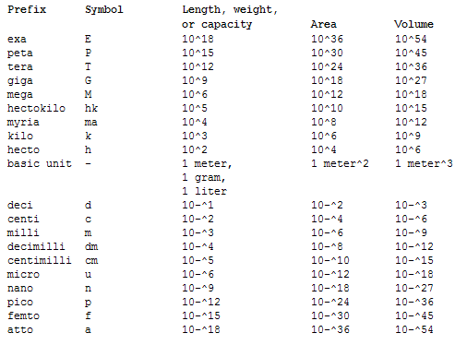
Notes:
You will see micro, nano, and pico prefixes a lot in science… pipettes especially
Giga, Mega – thing about your phone, or ipod, or computer storage mechanism……

Slide 106
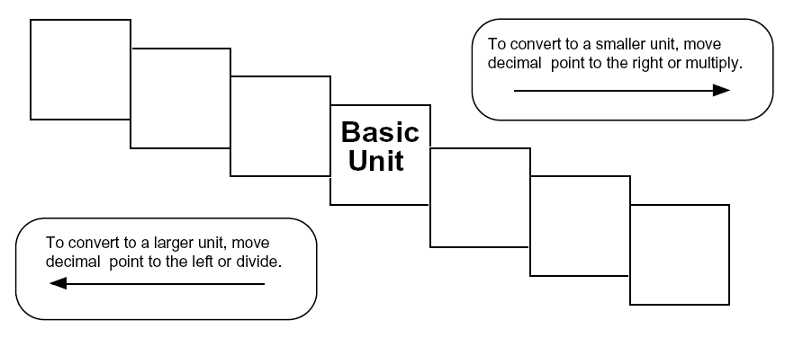
Ladder Method
1
2
KILO
1000
Units
3
HECTO
100
Units
DEKA
10
Units
DECI
0.1
Unit
CENTI
0.01
Unit
MILLI
0.001
Unit
Meters
Liters
Grams
How do you use the “ladder” method?
4 km = _________ m
1st – Determine your starting point.
2nd – Count the “jumps” to your ending point.
3rd – Move the decimal the same number of jumps in the same direction.
Starting Point
Ending Point
How many jumps does it take?
4.
__.
__.
__.
= 4000 m
1
2
3

Slide 107
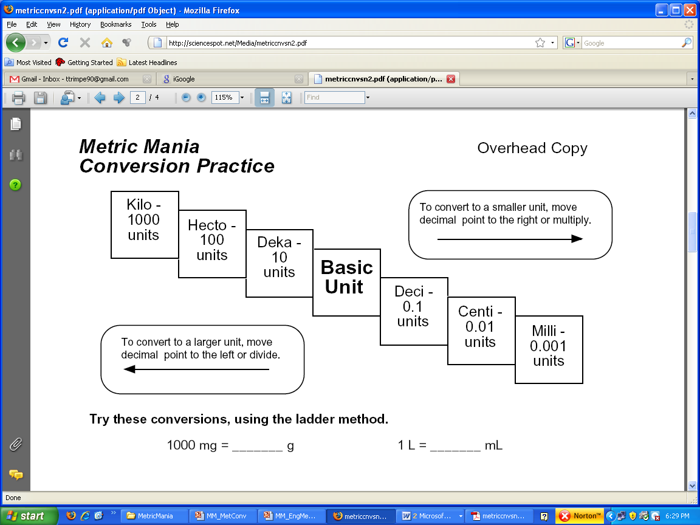
Conversion Practice
Try these conversions using the ladder method.
1000 mg = _______ g 1 L = _______ mL 160 cm = _______ mm
14 km = _______ m 109 g = _______ kg 250 m = _______ km
Compare using <, >, or =.
56 cm 6 m 7 g 698 mg

Slide 108
Warm-up (9-3-15)
What is the formula for area? How do you measure surface area?
What is the formula for volume? What are the units when solving for volume?

Slide 109
Outline
Objectives
Temperature Notes
Metric System Quick Labs – Length and Volume
Review
Conversions Practice

Slide 110
Objectives
To review the metric system
To demonstrate knowledge of the metric system by completing the metric system lab

Slide 111
Temperature
Celsius is the most commonly used unit of temperature
In the U.S. we use Fahrenheit
The SI unit of temperature is Kelvin
  Kelvin is the only scale with absolute zero – meaning no molecular motion
From To Fahrenheit To Celsius To Kelvin
Fahrenheit (F) F (F - 32) * 5/9 (F - 32) * 5/9 + 273.15
Celsius (C or º) (C * 9/5) + 32 C C + 273.15
Kelvin (K) (K - 273.15) * 9/5 + 32 K - 273.15 K

Slide 112
Metric System Quick Labs
As a table group, you will be responsible for completing the labs
Get through the length and volume quick labs today
You will need to put these into your comp notebooks
Follow directions
Show your work
Each member of the group needs to be working together

Slide 113
Metric System Practice 2
Convert 46cm to m
Convert 3 kL to mL
Convert 21 mL to L
Convert 64 grams to kilograms
Convert 713 mm to meters
Convert 3852 mL to Liters
Convert 620 mg to grams
Convert 55 cm to mm
Convert 1376 mm to kilometers
Convert 67 kilometers to mm

Slide 114
Metric System Practice 2
Convert 38cm to m
Convert 6 kL to mL
Convert 62 mL to L
Convert 26 grams to kilograms
Convert 345 mm to meters
Convert 2490 mL to Liters
Convert 432 mg to grams
Convert 75 cm to mm
Convert 2751 mm to kilometers
Convert 39 kilometers to mm

Slide 115
Metric System Practice 3
Convert 12cm to in
Convert 38 L to gallons
Convert 21 m to feet
Convert 42 grams to pounds
Convert 824 mm to inches
Convert 743 mL to fluid ounces
Convert 549 mg to ounces
Convert 59 meters to yards
Convert 13 quarts to liters
Convert 67 miles to km

Slide 116
Metric System Practice 3
Convert 67cm to in
Convert 57 L to gallons
Convert 33 m to feet
Convert 94 grams to pounds
Convert 384 mm to inches
Convert 618 mL to fluid ounces
Convert 726 mg to ounces
Convert 43 meters to yards
Convert 30 quarts to liters
Convert 64 miles to km

Slide 117
Review
What questions do you have?

Slide 118
Conversions Practice

Slide 119
Jeopardy
http://www.superteachertools.com/jeopardyx/jeopardy-review-game-convert.php?gamefile=../jeopardy/usergames/Oct201043/jeopardy1288021572.txt

Slide 120
Warm-up (9-4-15)
Write down as much as you can about what you know from the metric system unit.
  Think about unit prefixes, formulas, temperature, mass, volume, and length.

Slide 121
Outline
Objectives
Any last minute questions?
Test

Slide 122
Objectives
To demonstrate knowledge of the metric system by completing the metric system unit test

Slide 123
Test
No talking
Phones need to go in the box.
If I see you with your phones you get a zero. No questions asked.
Don’t write on the test itself.
Show work on the answer sheet, it might earn you some points!
I will pass out rulers and an unsharpened pencil
Turn in your tests to me, return ruler and pencil, get a vocab wordsearch

